Slide 1
Improving Legal Aid Agency decision making
Kate Pasfield
Director of Legal Aid Policy &
Member Services
Legal Aid Practitioners Group

Slide 2
LAPG’S ROLE IN POLICY WORK
We work to improve the delivery and administration of the legal aid scheme by engaging with the LAA on operational issues and the MoJ on the development and implementation of legal aid policy
We are a statutory consultee body for the LAA
We participation in the Civil and Crime Contract Consultative Groups, the Process Efficiency Team, the Quarterly Digital & Technology Meetings and numerous other informal and ad-hoc meetings and processes.
We seek to work constructively with the LAA and the MoJ as we have found that this is the most effective way of achieving meaningful change on behalf of legal aid providers.

Slide 3
LAA decision making and the culture of refusal
Between September and October 2019 we surveyed legal aid providers on their experiences of LAA decision-making
We received 540 responses to the survey
And 1852 examples of decision making by the LAA provided in the free text boxes that providers disagreed with

Slide 4
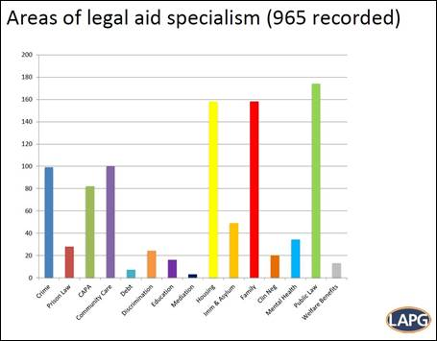

Slide 5
What did the survey tell us?
On the question of how many people had experienced incorrect refusals of substantive certificates and/or amendments to substantive certificates – 86% of respondents, so 326 people, said that yes they had
In the analysis of the free text examples, the issue of delay came up very frequently, causing particular problems such as firms working at risk and the impact on the client’s case in terms of meeting court deadlines. Delay came up in 41% of free text examples of poor decision making, which was the highest number.

Slide 6
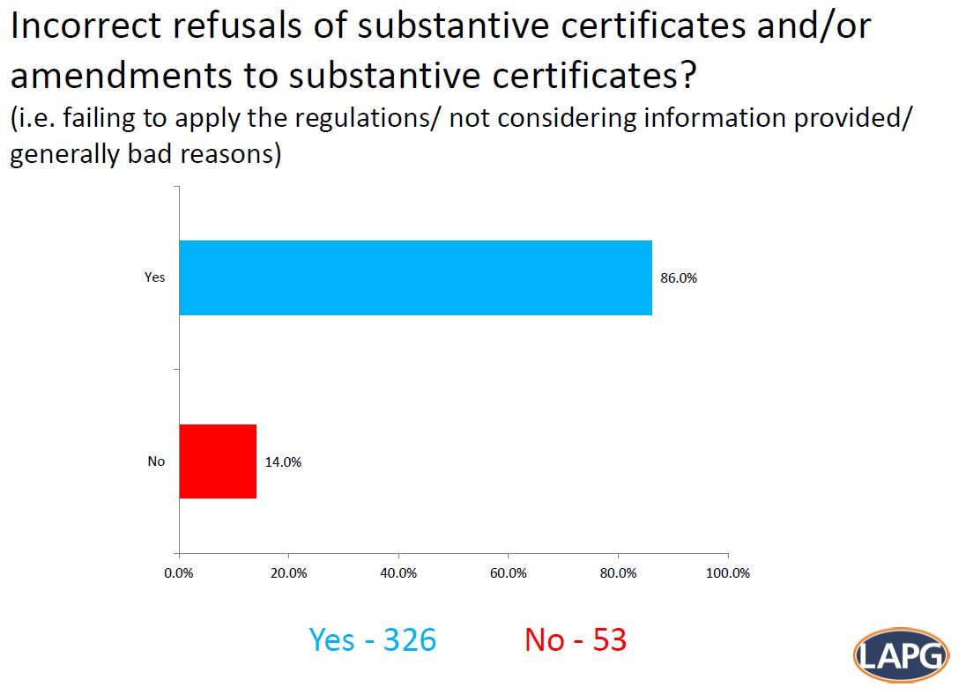

Slide 7
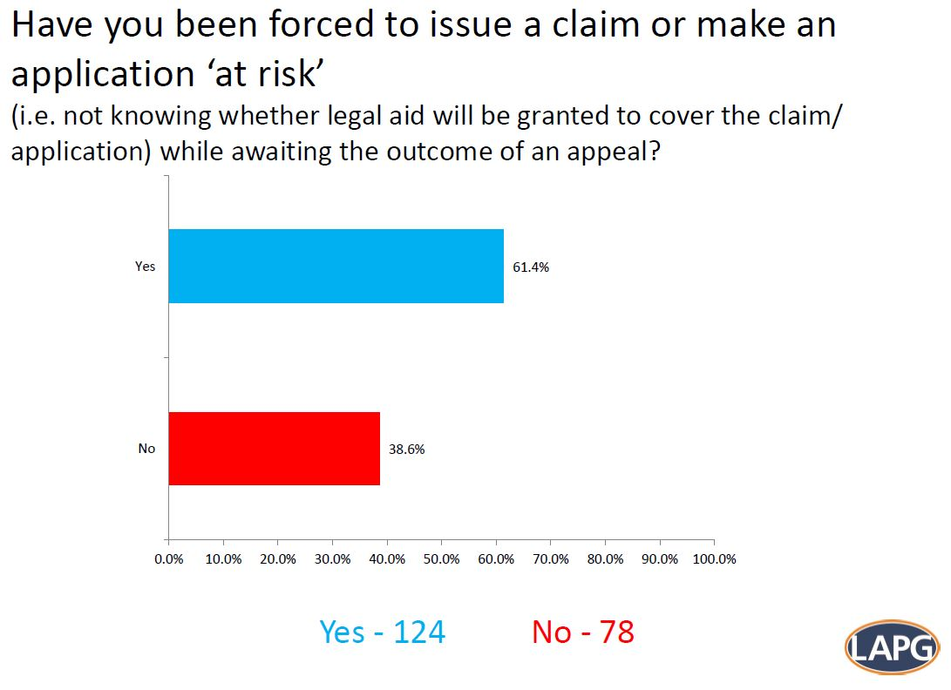

Slide 8
