Slide 1
...& MORE PUNISHMENT Tales from a broken system Dr Laura Janes and Andrew Sperling 9 November 2023

Slide 2
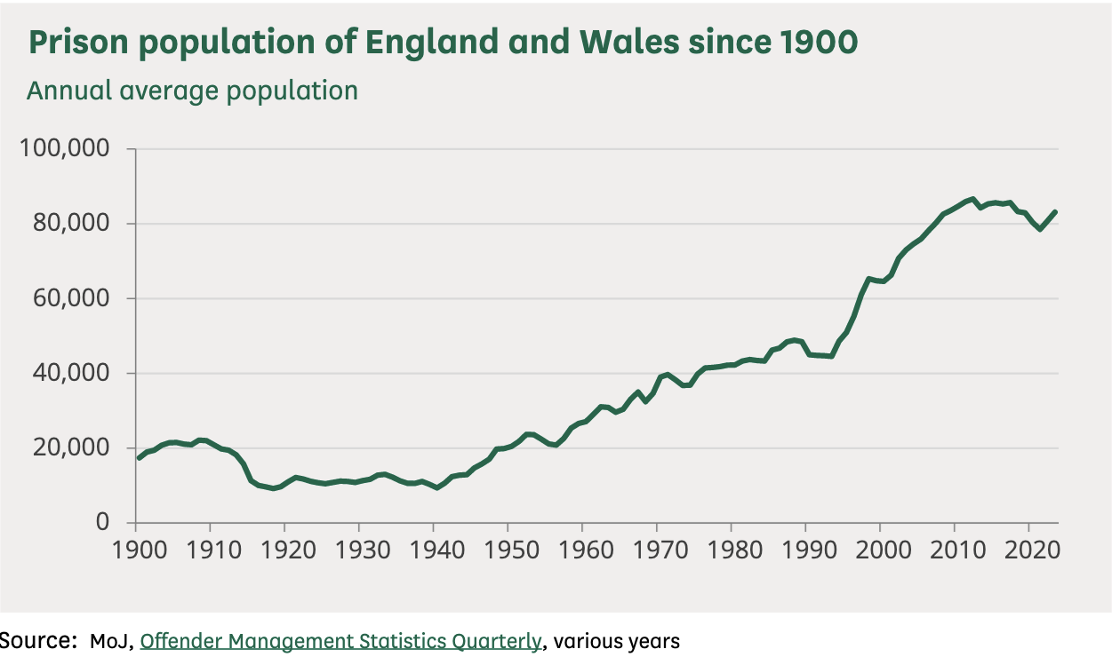
An unprecedented increase in the prison population

Slide 3
Desperate measures…and disastrous impact
November 2022 - operation safeguard! Police station cells being used…
https://hansard.parliament.uk/Commons/2022-11-30/debates/520966EF-BB43-4380-8800-21C46222BE00/PrisonCapacity
Suite of measures announced on 16 October to respond to the on-going overcrowding in prisons, including an additional 18 day early release scheme and reduction in use of prison for shorter sentences. Follows on from HDC extension from 135 to 180 days since June 2023
https://hansard.parliament.uk/commons/2023-10-16/debates/50D29A75-C1E4-4FFC-A77D-11BBC20BCD99/PrisonCapacity
“the last year has seen a 24% increase in the number of self-inflicted deaths, a 21% increase in self-harm incidents overall and a shocking 65% rise in women’s prisons. Levels of self-harm are now higher than before the pandemic, and self-harm by women has now reached its highest level on record” PRT
https://prisonreformtrust.org.uk/prt-comment-safety-in-custody/

Slide 4
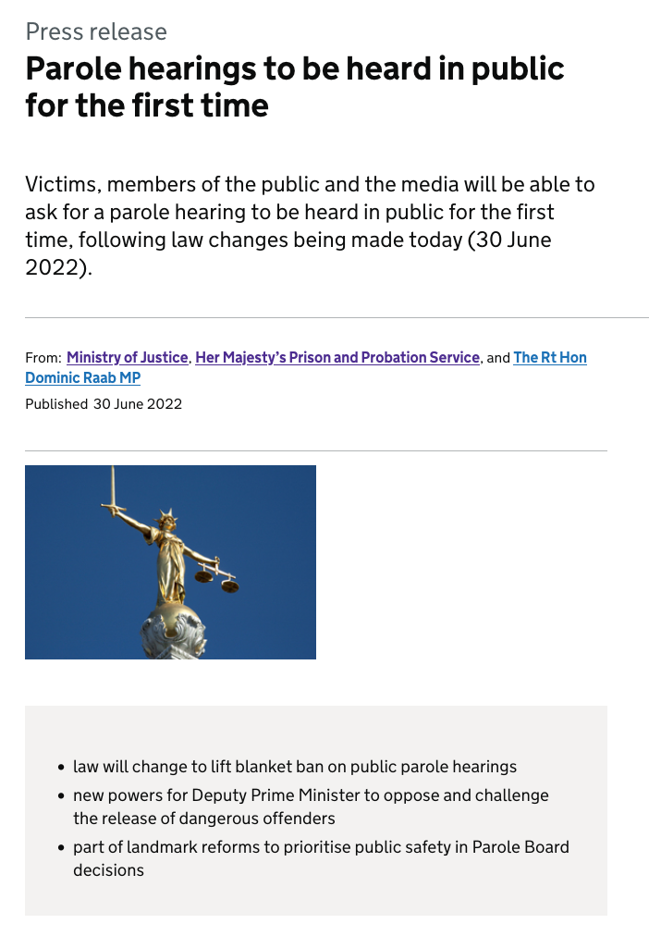
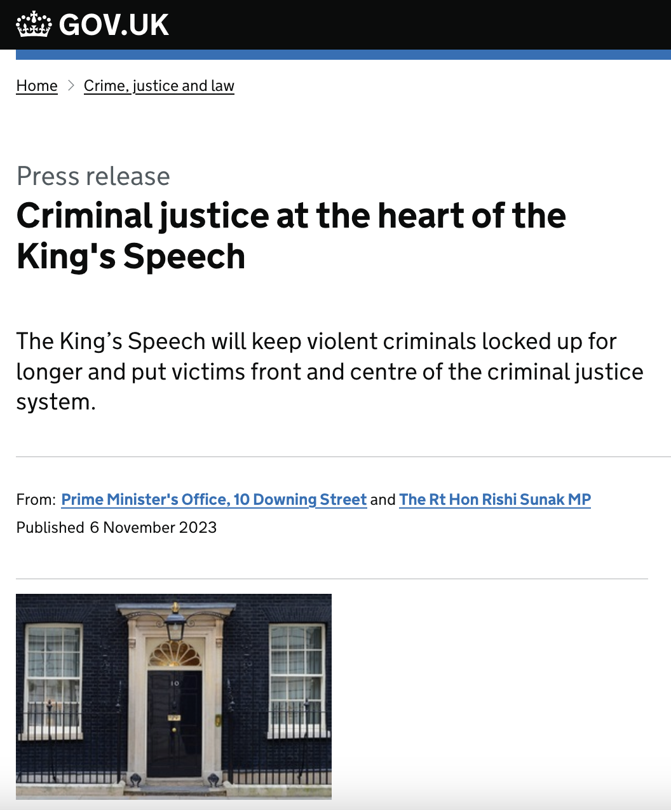
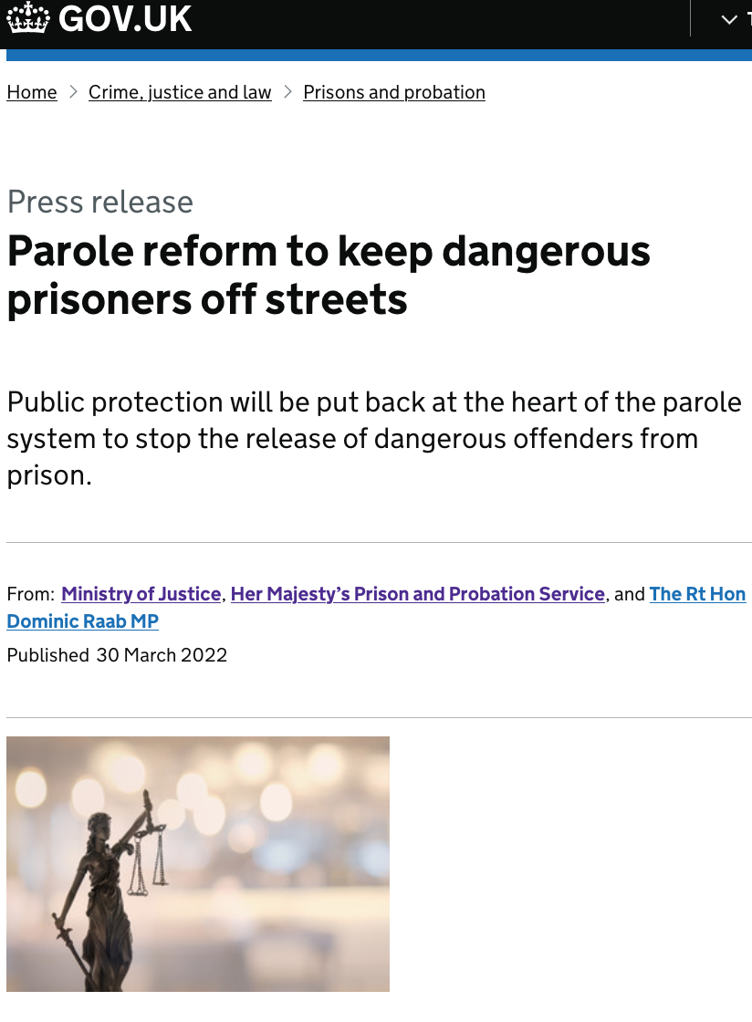
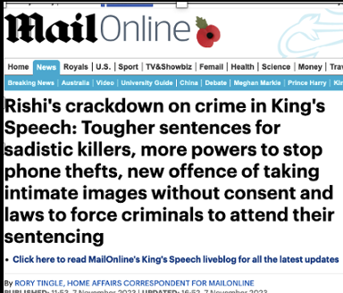
Tough on crime
Tougher sentences
Longer sentences
More parole
More complexity in parole cases
Harder to get out

Slide 5
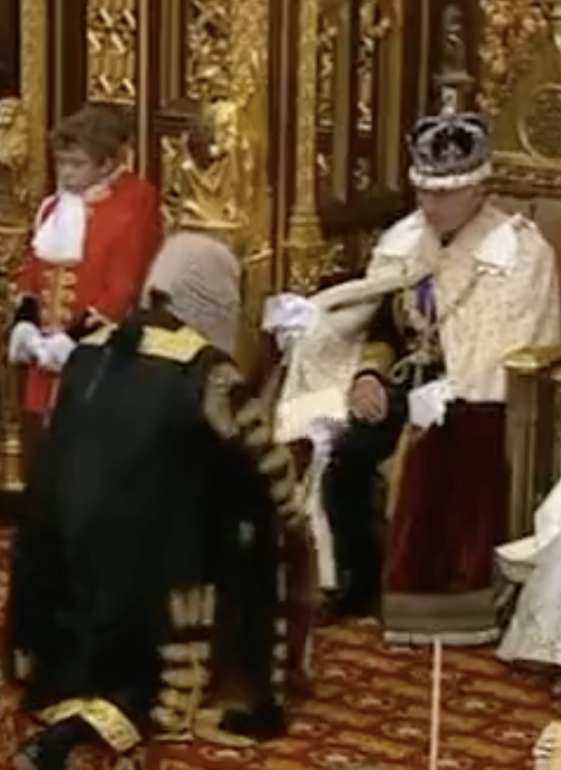
The King’s speech: the Good…
“….delivering public protection and cutting crime is not just about custody. There is persuasive evidence that suspended and community sentences are, in certain circumstances, more effective than short custodial sentences in reducing reoffending and aiding rehabilitation. In these cases, short prison sentences may even trap an offender in a revolving door of reoffending, cutting them off from work, housing, and family and further criminalising them with each spell inside.
This Government will therefore grasp the nettle and make a long-term decision that previous governments have ducked and legislate for a presumption that sentences of less than 12 months in prison should be suspended.”
We will “extend home detention curfew to suitable offenders serving sentencesof four years or more, so they can also be considered for the scheme…The exclusions that currently apply to home detention curfew to prevent violent, sexual and terrorism offenders, and those convicted of domestic abuse being considered for the scheme, will continue to apply.”

Slide 6
…the Bad and the Ugly
“mandate courts to impose a Whole Life Order in cases for which a Whole Life Order is currently the starting point, and murder with sexual or sadistic conduct, unless there are exceptional circumstances.”
“…we will ensure those that commit rape and other serious sexual offences will spend every day of their sentence behind bars and face the consequences of their actions.”
“…build a better justice system by establishing powers to transfer prisoners in and out of England and Wales to serve their sentence abroad..”
“The Bill will create a new “top-tier” of offenders convicted of the most serious offences (murder, rape, the most serious terrorism offences, or causing or allowing the death of a child) whose release may be subject to personal intervention by ministers so that there is a second check, on behalf of the public, on whether the prisoner is safe to release. ”
https://www.gov.uk/government/publications/the-kings-speech-2023-background-briefing-notes

Slide 7
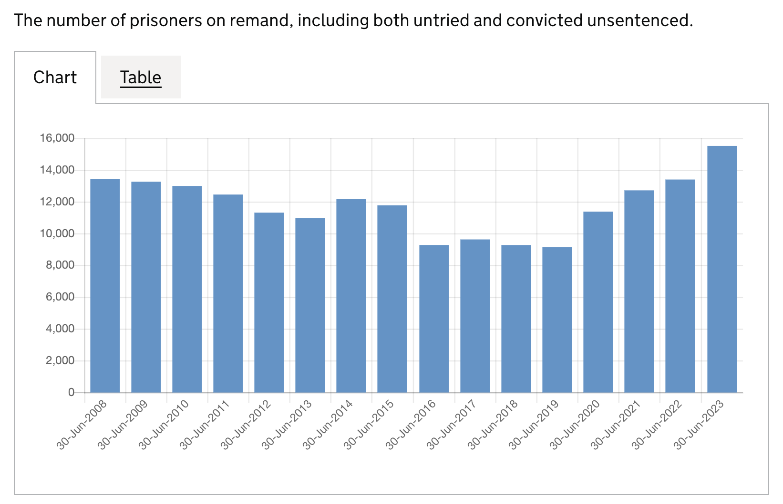
Remand and Recalls
The remand prison population as at 30 September 2023 was 16,196. This represents the highest level for at least 50 years (effectively a ‘record high’).
The ‘recall prison population’ (those returned to prison for breaching their release conditions) was 12,031 as at 30 September 2023 (15% higher than 30 September 2022, and also a ‘record high’).
There were 6,814 licence recalls between April and June 2023. This was a 19% increase on the same quarter in 2022.
Offender Management Statistics Bulletin, England and Wales Quarterly: April to June 2023 , Published 26 October 2023

Slide 8
Delays, deferrals and despair
How is the Parole Board responding to increased recalls, interminable investigations, court backlogs and unproven allegations?
Is there anything criminal lawyers can do to help recalled clients?

Slide 9
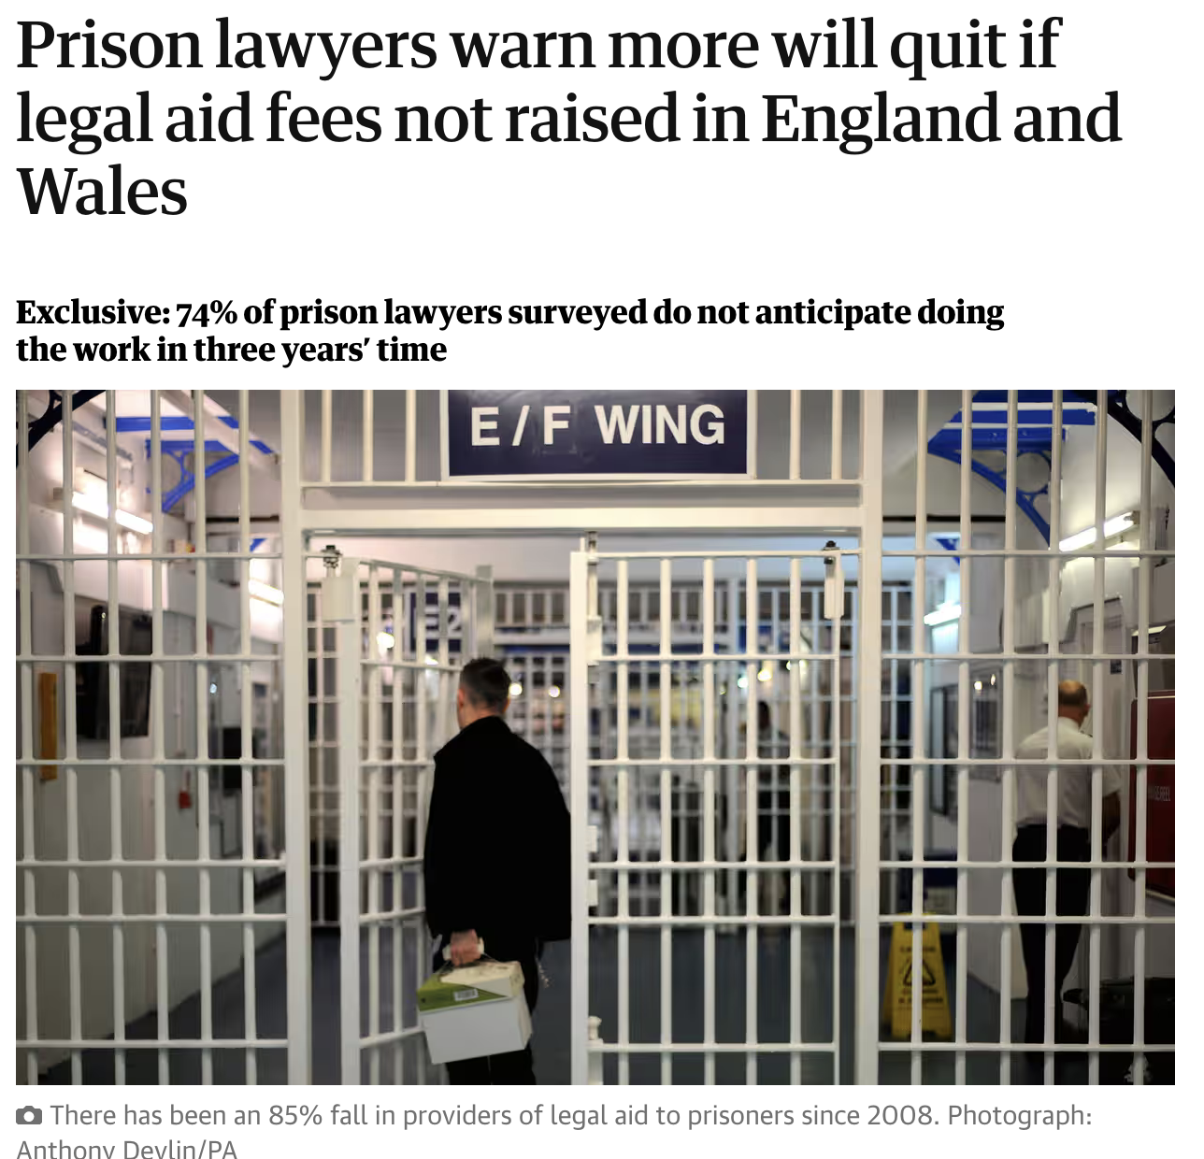
APL Survey
Summer 2023
Prison lawyers left out of 15% pay increase as govt prioritising the backlog
Prison law providers declined by 85% since 2008
Three-quarters of practitioners surveyed will not be doing legal aid work in 3 years’ time

