Slide 1
High-Cost Case Plans 09 November 2023
0370 300 3780
www.johnmhayes.co.uk

Slide 2
Introductions
The John M Hayes Partnership Limited
National firm of Costs Draftsmen/Costs Lawyers established in 1985. Specialise in all areas of costs, but particularly Legal Aid. Earlier this year became an employee owned business giving clients a more personalised experience of our services.
Laura Bennett
Worked at JMH for over 13 years now. Manages the firms London and South East region. Supports the CEO in managing the company and overseeing the firms legal aid clients. Specialises in Family Legal Aid Billing and particularly in high-cost care and international child abduction cases.
Jenny Beck KC (Hons)
Co-founder of Beck Fitzgerald Solicitors. An award winning family lawyer committed to access to justice. Member of The Law Society’s Family Law Committee Current co-chair of the Legal Aid Practitioners Group

Slide 3
Today’s session…
Basic Principles for High Cost Cases
Overview of CCFS/Events based case plans
Overview of Hourly Rates based case plans
Discussion and hints and tips

Slide 4
Basic principles for High Cost Cases
A case is high costs when it has been registered as a high cost case with the LAA because the costs are or are anticipated to exceed £25,000 (profit costs, disbursements & Counsel fees
Point of registration is when the Fee Earner considers that the costs are likely to exceed £25,000.
You are unable to register as high costs after a case has concluded. So, it is important to have costs in mind as case progresses. General rule of thumb consider registration when costs exceed £12,000 or a multiple day hearing is listed.

Slide 5
Procedure
To register a case as high costs submit a case query on CCMS notifying the LAA that the costs are likely to exceed £25,000.
For Care cases that fall under CCFS a simple notification advising of the above will suffice.
For cases that fall outside CCFS a breakdown of the costs incurred to date and the costs that will be incurred to bring the case to a conclusion will be required.
Once the LAA accept registration a Case Plan task will be opened in the notification window on CCMS

Slide 6
Care Case Fee Scheme (CCFS)
Since October 2015, all Section 31 Care Cases registered as high costs are to be billed under the Care Case Fee Scheme (CCFS). Also known as ‘events’.
Once registered and a case plan task is open you can immediately upload a signed high cost contract. This is not the case plan but the contracting document between the provider and the LAA agreeing that the case is to be billed under an individual case contract.
The template for this contract can be found here - https://www.gov.uk/guidance/civil-high-cost-cases-family
If Counsel have been instructed and are billing on events Counsel Acceptance Forms can also be uploaded at this stage.

Slide 7
Care Case Fee Scheme (CCFS)
High Cost Contract and Counsel Acceptance Form (CAF)

Slide 8
Care Case Fee Scheme (CCFS)
Once these documents are uploaded you can apply to increase your cost limit to £32,500.
This is without the need for a case plan to have been uploaded, or even drafted yet.
If Prior Authority has been granted for 2 Counsel i.e. X2 Juniors or Leader and Junior, you take the same steps as above but apply to increase your cost limit to £60,000 as opposed to £32,500.
If your final costs are going to exceed £32,500 or £60,000 (whichever is applicable) then you can submit an interim case plan for agreement which will then allow you to increase your cost limit further.
Alternatively, you can wait to submit a case plan at the end of the case. No strict time limits for submitting a plan but good practice to stay on top of it. No requirement for a plan to be submitted until the end, but within 3 months of conclusion of the case.

Slide 9
Care Case Fee Scheme (CCFS)
What if payment under CCFS isn’t right for my case?
All Care cases registered as high costs will be billed under CCFS unless it is agreed with the LAA at the time of registration that the case is exceptional.
*If urgent work required on the case and therefore no time to draft reasons in support of deviating from CCFS, can request to register but submit your reasons within 2 weeks.
If it is agreed that the case is exceptional then the case will be billed on the hourly rates case plan regime (an item by item basis).
To be exceptional, you must satisfy a 2 tier test;
The estimated total costs calculated at hourly rates including enhancement exceed the total costs calculated using the CCFS model by more than 30%
The case is exceptional in nature

Slide 10
Care Case Fee Scheme (CCFS)
Example of circumstances that made lead to a case being ‘exceptional’
Issue of law that is new or issues of public policy
Highly unusual factual matrix
Dispute between experts, resolution of which likely to result in different outcomes to the case
Extensive number of witnesses
Level of client contact goes beyond that which would normally be expected e.g. a client with severe mental health or learning impairment or disability
Late change in representation

Slide 11
Care Case Fee Scheme (CCFS)
When seeking to agree that a Section 31 case is ‘exceptional’ and therefore should be billed on an hourly rates basis this template is to be completed and sent to the LAA.
They will consider the information provided within the template and make a decision within 5 working days.
If you are unhappy with the decision you can submit an appeal.

Slide 12
How and how much will I get Paid?
You are paid by reference to the number of events. For solicitors these are Hearings and Advocates Meetings (whether for 5 mins or a full day).
No payment for Conferences or Expert Meetings.
Only allowed to be paid for 1 event a day so ensure Advocates Meetings and Hearings are scheduled separately.
Ensure all Advocates Meetings are ordered in advance – see hints and tips sheet at end of this session!
Once on CCFS entire case is paid on events.
The fee paid per event depends upon the type of model adopted (and there are many!). Your Costs Draftsman will ensure you claim your costs on the most profitable model.

Slide 13
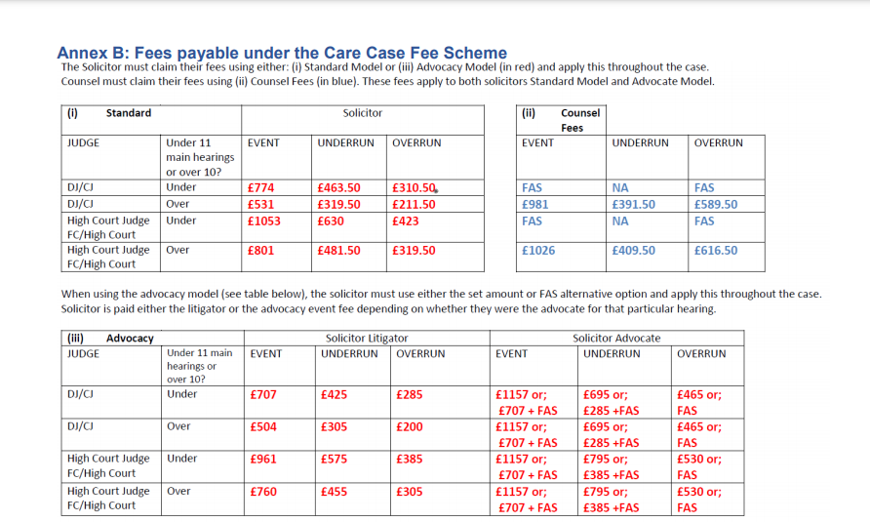

Slide 14
How and how much money will I get paid?
As per the previous slide various factors to consider when selecting which model applies to your case;
Whether there is a Single Advocate or authority for 2/Leading Counsel.
Whether the Solicitor or Counsel undertakes the advocacy.
Whether the ‘main hearing’ is more or less than 10 days.
The level of the Judge
N.B. Single Counsel events can have all Advocates Meetings whether you or Counsel attend them (so long as ordered in advance) but 2 Counsel events limited to 2 Advocates Meetings and must attend them.

Slide 15
How and how much money will I get paid?
You can switch CCFS models during the life of a case to ensure that you are on billing on the most profitable model.
It is good practice to keep a log of all ‘events’ on each file to help you and your Costs Draftsman determine which scheme is the most profitable not just at the point of registration but as the case progresses. See example to the left.
Also, it is good to keep this log as the biggest benefit of CCFS is that you can claim a 100% POA for all events incurred to date.

Slide 16
Overview of Hourly Rates based plans (Family and COP)
Hourly rates case plans are utilised for all non-care high costs matters and the ‘exceptional’ care matters.
The procedure and process for registration was set out earlier in the session.
As per earlier, once agreed with the LAA that the case is high costs they will open a case plan task.
Unlike the CCFS scheme, you will be required to submit a plan strictly within 28 days.

Slide 17
Overview of Hourly Rates based plans (Family and COP)
A case plan will be prepared which includes a stage for pre-contract costs (all costs up to the date of registration – call it 1 June 2023) and a stage 1 of estimated costs from the date of registration until the next logical point, which is usually a hearing date. So, for example stage 1 could be from 1 June 2023 up until a hearing listed on 1 September 2023.
The LAA will then consider the plan and either;
1) accept the costs/estimates and issue a contract to be signed for the total sum, or
2) look to reduce the costs estimated/proposed enhancement or raise some queries.
LAA usually look to reduce the costs in the case plan and this can create a lengthy back and forth negotiation on the costs to be agreed.
Once the hearing on 1 September 2023 has taken place, if the matter is ongoing (and listed for a further hearing on say 1 December 2023), the LAA will expect an updated case plan with estimated costs from 2 September 2023 until 1 December 2023 – this will be called stage 2. The LAA allow 28 days from the conclusion of the previous stage to submit the updated case plan with a new stage.

Slide 18
Overview of Hourly Rates based plans (Family and COP)
In the meantime, as the LAA have agreed a contract for pre-contract and stage 1 costs, once you upload the signed contact and the funding limit has been increased to reflect this you are free to go ahead and submit your interim bills for pre-contract and stage 1 costs. However, you are also free to apply for payments on account of profit costs in the usual way.
And so on until conclusion of the case.

Slide 19
Overview of Hourly Rates based plans (Family and COP)
Things to note - Different type of document to CCFS
- strict 28 day time limits/deadlines with risk of cost sanctions
- All costs should to be agreed in advance by the LAA in stages to the certain landmarks, usually a hearing (in theory anyway!).
- Family fee earners to note - no more FAS, all advocacy/preparation/travel recoverable at hourly rates so all fixed fee billing elements go out the window when on this billing regime.
- Your case plan should reflect the agreed costs per stage not actual costs. So the case plan should match the agreed global cost limitation that is applied on CCMS.

Slide 20
Overview of Hourly Rates based plans (Family and COP)
To avoid confusion as to the various figures flying around it is good practice to keep a log that can be easily referred to for each case, as in effect you have 3 sets of figures for each stage of the case plan;
Those sought
Those agreed
Those actually incurred
You are paid the costs actually incurred but those agreed are your cost limitation.

Slide 21
Overview of Hourly Rates based plans (Family and COP)
Family Cases only – recent change
Pre Contract costs are no longer being considered by the HCCP team but are being assessed separately by the finance team.
This means a notional £25,000 is added to your Stage 1 costs to give you an overall price/cost limitation
The Pre Contract is submitted by way of interim bill for assessment but this can only be done after a contract has been agreed, signed and uploaded to the case plan task. Therefore, you have to wait for the negotiations to come to a close on a stage before you can be paid for the pre contract work.
Pre contract assessed by entirely different team meaning you can end up with a totally different assessment i.e. discretionary enhancement percentage…!

Slide 22
Overview of Hourly Rates based plans (Family and COP)
Agreeing a price for hourly rates case plans
The negotiation process to agree an hourly rates plan can be convoluted and protracted in Family Cases. COP case plans far simpler to agree, but COP is a growing area of work so this may start to be regulated in more detail like family in time to come.
We will now discuss what we have experienced a lot of during the negotiation process in family hourly rates case plans to include;
- global offers
- discretionary enhancements
- routine correspondence
Notes:
Global offers – broad brush offer as opposed to considering item by item. Can work if the stage has concluded and you can quickly compare the offer to your time recording system
Enhancements discuss levels that can be applied and reductions we often see
Routine correspondence – discuss how these should be recorded (Jenny)

Slide 23
VHCC - Hints and Tips
Laura will hand out a hints and tips sheet.
If anyone would like to go through or discuss the sheet or discuss a particular case please feel free to email Laura on;
laura.bennett@johnmhayes.co.uk
Or call 0370 300 3780 to speak to a high cost case specialist at John M Hayes

Slide 24
John M Hayes – we’re social ☺
LinkedIn: The John M Hayes Partnership
Facebook: /johnmhayespartnership
X formerly known as Twitter: @John_M_Hayes

