Slide 1
Vulnerable clients in criminal proceedings Dr LAURA JANES November 2023 info@laurakjanes.co.uk

Slide 2
Overview
How prevalent are needs across the CJS?
The lack of formal mechanisms in criminal and quasi criminal proceedings
Relevance to substantive law
Adaptations to the process
Practical issues for lawyers

Slide 3
Needs in the CJS
One in five criminal cases involves a victim, witness or defendant with a mental health condition (CPS research, 2017);
76% of female and 40% of male remand prisoners have a mental health condition,
29% of those serving community sentences have a mental health condition
People from minoritized communities are disproportionately represented in the criminal justice system (Lammy 2017); and 40% more likely than white people to access mental health services via a criminal justice pathway (Healthcare Commission Census, 2007).
Between April 2014 to March 2016, assessments of young people entering custody showed concerns relating to: self-harm or suicide (31%); physical health (3%); mental health (33%); learning disabilities or difficulties (32%); (MOJ, 2017)
Upto 50% of the prison population cannot read well enough to take part in functional skills courses at level 1 or above (HMIP and Ofsted, 2022)
See
https://www.cps.gov.uk/cps/news/howard-league-penal-reform-parmoor-lecture
https://www.gov.uk/government/uploads/system/uploads/attachment_data/file/585991/key-characteristics-of-admissions-april-2014-to-march-2016.pdf
https://www.gov.uk/government/publications/prison-education-a-review-of-reading-education-in-prisons/prison-education-a-review-of-reading-education-in-prisons

Slide 4
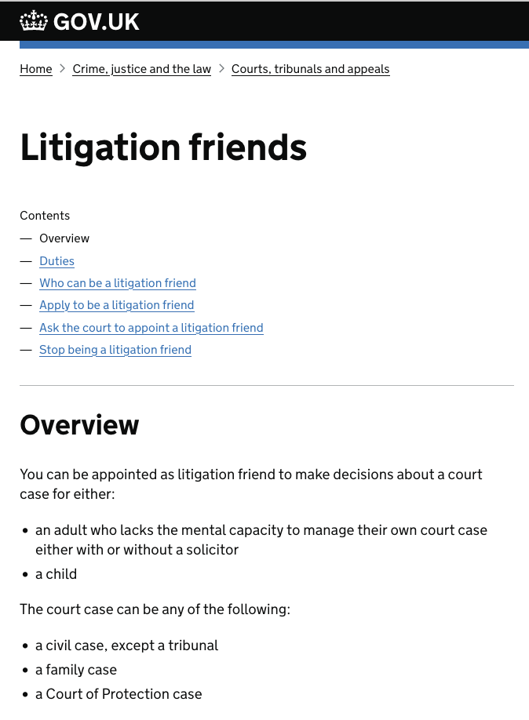
Lack of formal mechanisms for representation
No litigation friend possible, except in parole proceedings – see EG v Parole Board & ors [2020] EWHC 1457 (Admin)
https://www.bailii.org/ew/cases/EWHC/Admin/2020/1457.html
Mackenzie friend possible in adjudications only
Criminal practitioners expected to “muddle through”?

Slide 5
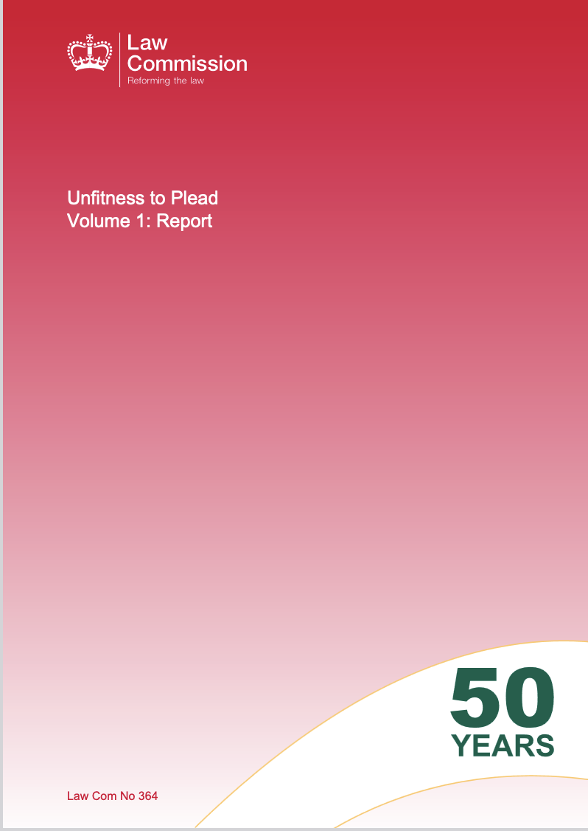
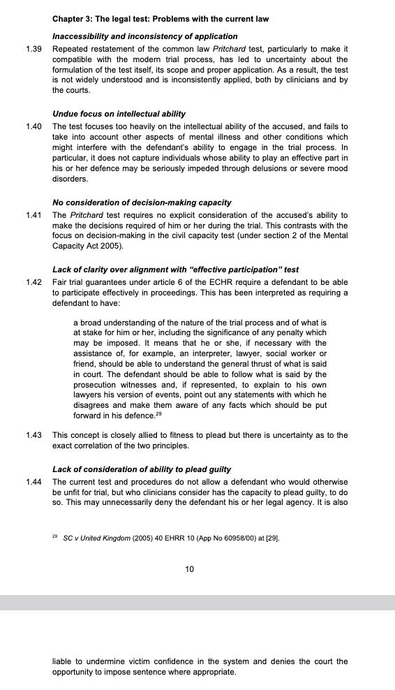
SUBSTANTIVE Criminal law and capacity
A person may be found to be “unfit to plead” if they meet the “Pritchard” test (1836) 7 C & P 303, 173 ER 135; focused on procedural aspects of the criminal case
Law Commission concerns & proposals for reform - 2015. Government response published 1 November 2023
Intent – mens rea
Age of criminal responsibility – 10 years old
CPS Code – interests of justice
Blunt tools for the complexity of forensic realities…

Slide 6
ADAPTATIONS
Where a client who in civil proceedings would lack capacity, in criminal proceedings the focus is on adaptations and special measures
Criminal procedure rules – see practice direction 6 “VULNERABLE PEOPLE AND WITNESS EVIDENCE”:
“The court is required to take ‘every reasonable step’ to encourage and facilitate the attendance of witnesses and to facilitate the participation of any person, including the accused. This includes enabling a witness or accused to give their best evidence, and enabling an accused to comprehend the proceedings. The pre-trial and trial process should, so far as necessary, be adapted to meet those ends.”
Intermediaries, breaks, ground rules hearings etc
Advocate’s Gateway and the Equal Treatment Bench Book

Slide 7
PRACTICAL ISSUES
As with civil, how to you get past the first hurdle of understanding need?
Burden remains on representatives to:
identify issues, and
work out how to meet them
Commissioning reports – who to instruct, how to secure reports
Obtaining background information is key – friends, family, statutory services…
Legal aid, the churn of cases and the haste of the system makes this difficult - practitioners are penalised financially for accommodating need
How do you take instructions and earn trust?
Ethically
Practically

