Slide 1
Maximising Costs and Recoveries
9th November 2023

Slide 2
Introduction
Shaun Williams – Assistant Regional Manager of John M Hayes Wales and South West Region
National firm of Costs Draftsman/Costs Lawyers, established in 1985.
Specialise in all areas of costs, including family legal aid and claims from the Legal Aid Agency.
Newsletter and blogs along with details of our services on website.
Shaun.Williams@johnmhayes.co.uk
Notes:
- 15 years of experience/changes/developments – processing with LAA
- Maximise costs / efficient
- Questions…?

Slide 3
Introduction
In recent years Legal Aid Work has been severely impacted
In terms of the type of work covered and the rates payable
It has never been more important to make sure that you are billing efficiently in your cases in order to maximise you costs.
Notes:
Reason we do this talk…reductions…. work with what we’ve got.
None of this meant as criticism, we understand work pressures, but ultimately about improving time recording and in turn improving recoveries from the LAA.
Example of care fixed fee vs exceptional claims.
If you have any questions let us know and will try to deal with them as we go along (confirm – 45 mins not v long).
Alternatively see me at the end or email me your query and we will assist.

Slide 4
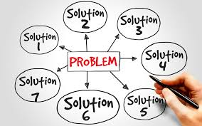
Introduction
There are three basic principles:
Ensure you are covered for the work you are going to do.
Claim everything that you are entitled to claim for.
Ensure that the billing process works smoothly so that you don’t encounter rejected claims and therefore delayed payment.
Notes:
Much of what I’m going to discuss revolves around these three headings

Slide 5
LEGAL AID CERTIFICATES
Notes:
The first thing we will do as Costs Draftsmen…

Slide 6
Legal Aid Certificates
The legal aid certificate sets out the type of work that you are covered for and the steps that you can and can’t take.
The first fundamental step in maximising your legal aid costs is ensuring that there are no funding problems.
Two Areas to be considered:
Scope Limitations
Costs Limitations
Notes:
Crucial to be familiar with what you have on your certificate and if it is enough – scope (what you can do) – costs (what you can be paid for)
Scope- What are you covered for?
Costs- How much are you covered for?
Side note – you can claim the time for checking your funding certificate scope, limitation and costs limit details

Slide 7
Legal Aid Certificates Scope Limitations- Emergency Certificates
Emergency certificates limited to a date or step
This take precedence over the 8 weeks
Amend the emergency when required

Slide 8
Legal Aid Certificates Scope Limitations- Type of Case
Things to consider……
Are you covered for everything?
All Substantive issues?
Work in relation to Appeals?
Notes:
Black and white for LAA – 1) residence matters conclude but more hearings in relation to contact issues only, could be in bother recovering any children work
2) possession proceedings and a counterclaim is made – do you have cover for the counterclaim.
Most common examples of issues are:
- Children matters – level 3 and 4 cover. As soon as final hearing is listed, apply to amend the scope for final hearing. Explain.
- Appeals- No amendment is required to undertake work on an interim appeal. An amendments is required if appealing a final order.
Tip- If you are unsure whether your certificate covers you, (1)ask us or (2) make an application to the LAA

Slide 9
Legal Aid Certificates Cost Limitations
The cost limitation has to cover the total cost of the case (excluding VAT and costs of assessment). Factors to consider:
Highest figure on the certificate at time of assessment
Family Cases – automatic £25K since April 2019
If relying on time recording ledger, is it accurate? Rates, FAS fees/bolt ons sometimes not considered.
Do you have further disbursements to be incurred?
Has Counsel been instructed?
Will you be claiming an enhancement? Panel member and discretionary/additional.
Is there room for the costs of preparing and checking the bill?
Notes:
All things to bear in mind. You don’t want to be working for free under any circumstances! We have seen costs significantly limited due to being unaware of the level of costs, leaving no room for enhancements etc
Important to have costs reviews/system in place – monthly?
If going over £25,000 remember to register as high costs, or be limited to £25,000

Slide 10
Legal Aid Certificates Cost Limitations (Continued)
What happens if you have exceeded the limitation?
Your costs will be capped to the costs limitation with disbursements and Counsel being paid first as priority.

Slide 11
Recoverable
Costs

Slide 12
Claimable Work Profit Costs- General Rules
Rule of Thumb:
Preparing document- 6-12 minutes per page of A4 (CAG 2.15)
Considering documents- 2 minutes per page of A4 (CAG 2.12)
However, record your time based on how long the task has taken you as opposed to being stuck with the general guidance. Don’t base it purely on length of the document.
Notes:
‘as a very rough guide’
Example of letter prep.
Example of brief to Counsel
Will depend on the document quality and layout, and documents of greater complexity may warrant more time (try to justify this in any attendance notes)

Slide 13
File Notes
Use your attendance notes to justify your time, especially if the time is higher than the general time guidance in CAG:
Consideration time:
Quality of the document (handwritten notes)
Size of font
Documents of greater complexity
Preparation time:
Especially complex matters to address
Explaining evidence to vulnerable client.
Carefully wording advice for client/mental health issues.
Importance of document being drafted

Slide 14
Claimable Work Profit Costs- General Rules
File Notes:
A well maintained file should detail every piece of work that is to be claimed.
The LAA will check a claim against the file:
In cases when papers required for LAA assessment of costs
When the file is part of audit
When the file is selected following a Court Assessment
Estimated time is very unlikely to be allowed without supporting evidence.
The file note must include sufficient detail to justify the work that was carried out.
Notes:
LAA approach – quite simplistic eg 1 hour letter to client.
Cannot stress the importance of file notes- (1) if you us or cost drafting firms then this is what we will use to prepare a claim or bill (in addition to time ledgers)
We can and usually estimate time that we think you may have missed but would have had to consider particular documents (maximising your costs) we would then prepare a schedule of this estimated time in order for you to prepare the relevant attendance notes to go on the file.
Essentially if the file note is not there, the LAA will reduce the time (losing out on costs!)

Slide 15
File Notes
The LAA now require file notes for all entries of 3 hours and above as part of the supporting bundle of documents when submitting a claim.

Slide 16
Claimable Work Profit Costs- Examples
Claimable Items (often overlooked)
Preparing detailed file notes (1.28)
Preparing and updating master Court Bundles (2.16)
Sending text messages and WhatsApp messages (2.30)
Checking the application of established law or procedural rules (2.6)
Legal Research (2.5) if it relates to an unusual, developing or novel area of law
File Reviews (2.39-2.40). Usually a one month gap in work
Travelling to attend the Client in exceptional circumstances (2.47)
Drafting long or complex letters (2.19)

Slide 17
Claimable Work Profit Costs- Examples
Commonly recorded but UNRECOVERABLE time;
File opening procedures (CAG 2.1)
Supervision (CAG 2.37)
General Inter fee earner discussions (CAG 2.37)
Time spent scanning and photocopying documents (CAG 2.2)
Although the time spent selecting the documents to be scanned is recoverable
Duplicative letters or telephone calls (CAG 2.18 (a) )
Copying Trial Bundles (CAG 2.16)
Multiple letters sent during one day (CAG 2.18 (b))
Letters arising from the oversight of a fee earner (CAG 2.18 (c ) )
Reviews on reallocation (CAG 2.41)
A review may be recoverable if the matter has been reallocated out of the control of the solicitor
Notes:
Bundles- identifying the documents and drafting index can be claimed but not for preparing copies of the bundles
Solicitors are not expected to be walking law libraries- can check on the application of established law or procedural rules to individual circumstances- file note to justify-

Slide 18
Allowances in CCMS– Costs Assessment Guidance
Allocation of Costs to Counsel- 12-18 minutes
All other amendment applications- 24-30 minutes
Payments on account- 12 minutes
Hourly rate claim on CCMS- 24-30 minutes per 10 items
Reporting outcomes with no costs or statutory charge- 12 minutes
Reporting outcomes with costs or statutory charge- 24 minutes
CCMS notifications- routine
Take away message is that nearly all work undertaken in CCMS is recoverable so ensure this time is recorded!

Slide 19
Practical Guidance
Prepare detailed file/attendance notes as you actually do the work, as doing it at the end of the day could result in time recording being missed.
The file/attendance note needs to be detailed enough to justify the time being claimed;
Time can also be claimed for preparing the file/attendance note, which means that you are not losing out on time for justifying the work undertaken;
Claim time for CCMS based activities as this is time that is commonly unrecorded (N.B considering a notification and preparing a response can either be claimed as routine correspondence or on a time spent basis if it took longer than 6 minutes);
Make sure you are aware of all commonly unrecorded time that you can actually claim to maximise your costs. Lost WIP will also mean lower POA claims and so impact on cash flow as well as profit.

Slide 20
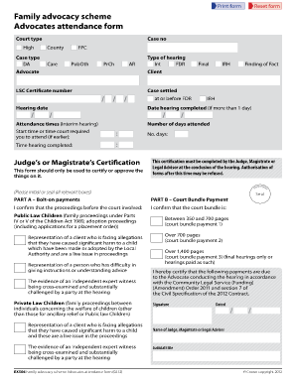
Maximising FAS Costs

Slide 21
FAS - Top Tips
Do your own advocacy if possible!
Escape Unit 1 at interim hearings
Get your bolt-ons authorised
Be careful when recording items as preparation for hearing
Where possible minimise travel time per case
Notes:
The FAS fees can often form a significant proportion of the costs payable on a case
Getting beyond the 60 minute mark makes a significant difference, ensure pre hearing discussions are within the order
Examination of Expert/Lack of Understanding/Allegations of Harm or the Court Bundle there is also the exceptional travel bolt on for journey’s that excessed 25 miles each way this just needs to be justified when submitting the claim
Recording Items- drafting order at court falls under FAS fee, consent order in office = profit costs, attendance note = FAS, position statements = FAS
LAA to use discretion on Affidavit’s, Case Summary, Chronology, Pleadings, Skelton Arguments, Witness Statements
Travel time is not paid separately and therefore you will not be getting recognition for travel time

Slide 22
FAS
On submission we have recently experienced the odd issue with FAS/hearing time calculations.
When the above time is calculated (8.30am to 10.48am), this totals 2 hours 18 mins which would equate to a unit 2 FAS fee. However, the total time at the end is incorrectly noted as 2 hours 48 mins which would be two unit 2 fees.
A no-win situation!

Slide 23
Enhancements
What is an enhanced claim
Minimum Guaranteed Enhancement vs Discretionary
Maximum Cap on Enhancements:
100% in the High Court, Court of Appeal (including cases in Family Court being heard by a High Court Judge)
50% in all other cases (e.g County court, Non High Court Level Judge in Family Court etc)
Notes:
Rule of thumbs – enhancement to be applied to all claims which exceed exceptional threshold.
Advice your CD if you feel like you should be entitled to an enhancement….
Case specific but LAA assessments quite fair/favourable. If you don’t ask you don’t get!

Slide 24
Disbursements/Expert Fees
LAA currently stricter on expert fees - be aware of:
Recoverable guideline rate for each type of expert.
Invoice to provide breakdown of work done
Details of travel/postcodes and receipts for expenses.
If expert charges too much, they will ultimately get paid in full whilst the LAA will only pay you back the amounts set out in the guidance. This shortfall will cut into your profit costs recovery.
Notes:
Not just profit costs….

Slide 25
Recording Time and How We Cost a File

Slide 26
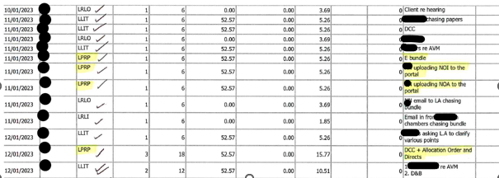
Ledgers
Ledgers are used in conjunction with the documents on file.
Notes:
Example of a well recorded file, each entry matches the file perfectly.
If anything missing there is a brief description on the ledger to assist us

Slide 27
Ledgers
Example below highlights items recorded on ledger but not showing on the file.
Notes:
Items highlighted in pink were not included on the file, so as a Draftsman you have a decision to make as to whether to claim these items and can create inconsistencies.
If claimed, potential issues if the LAA were to audit the file

Slide 28
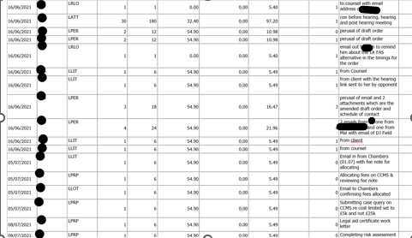
Examples
The example below demonstrates a ledger that would enable for faster and more accurate costing of a file. A description is provided for each entry and each routine entry is claimed on a separate line.
Notes:
You might think it’s not your job to make things easier for a Draftsman, however in our experience, files that are well recorded and organised will:
Get paid faster by the LAA – all documents available.
Achieve higher recoveries and less reductions.
Have less rejects on assessment/better KPI rate

Slide 29
Summary
Be aware of your funding certificate cover/scope/limitations – regular reviews.
Ensure you are covered for all work.
Record all of your recoverable time.
Prepare file notes to justify your time (your file note preparation time is recoverable!)
Advocacy/FAS
Ensure expert fees in line with LAA guidance.
If you’re unsure – ask your Draftsman!

Slide 30
We’re Social
LinkedIn: The John M Hayes Partnership
Facebook: /johnmhayespartnership
Twitter: /John_M_Hayes

