Slide 1
LAPG UPDATE ON PUBLIC LAW NOVEMBER 2023 (current developments)
Lucy Verity
Director , Philcox Gray

Slide 2
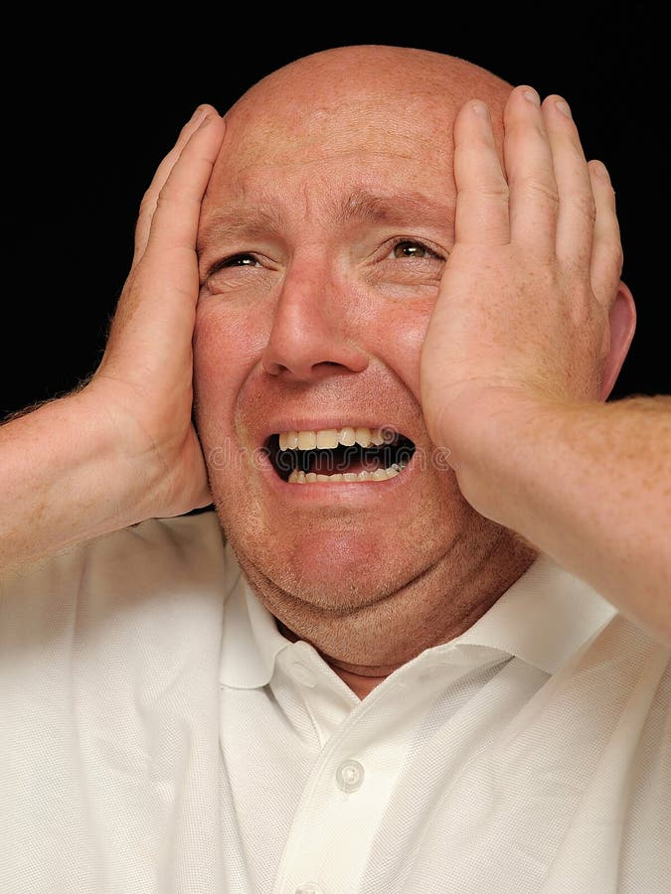
LAA Online Portal Welcome to the Online Portal. Please click a link below to access the application you require. If you experience any problems using the Online Portal, or would like to view guidance documents for the Online Portal applications, please click on the help link on this page.
Online Applications:
Contracted Work and Administration (CWA)Submit Crime Lower, Legal Help Level 1 and 2 claims, Mediation Claims, New Matter Starts and manage your Online Users and Contacts
Management Information (MI)View your Organisation's financial information
Electronic Forms (eForms)Complete online forms for: Civil POA, Crime CRM 4,5,7,14
Client and Cost Management SystemFor applications for civil funding
Apply for criminal legal aidThis is a new service to apply for criminal legal aid. We will contact your law firm when you can use it. Until then, apply using eForms.

Slide 3
LEGAL AID
Since 1 May 2023 legal aid is extended to respondents with PR (ie parents and LA) and prospective SG making the application in private law proceedings.
Does not cover
parent who wants to apply to discharge SGO (difficulties with eligibility and gateway)
Prospective SG within existing public law proceedings. How much will LAs pay for advice?
Apply on CCMS using the SCA option.

Slide 4
LEGAL AID
Relaxation of merits test for parents wishing to oppose adoption / placement orders.
MoJ guidance states that, “The nature of these cases and the desirability of the parent/person with parental responsibility being represented may be sufficient to satisfy the merits criteria and justify the provision of representation. “

Slide 5
SUPERVISION ORDER CONSULTATION 2023
How can supervision orders be made more effective?
What happens after a supervision order is made?
Is it all down to resources?
Consider alongside the best practice guidance on SGOs
Consider case of Re JW discussed below.

Slide 6
FINDINGS FROM RESEARCH
Families said that the supervision order could have been made to work better and more effectively for them and their families.
One of the 6 core principles therefore is that there should be clear tailored plans including to address ongoing risks, and the findings and conclusions of the court in care proceedings

Slide 7
SUPERVISION PLANS
Supervision order plan template
Annex A - Supervision Order Plan (judiciary.uk)
Parents should be involved and consulted on the plan when it is drafted.
As practitioners therefore, whether acting for children or parents, we should be actively involved in ensuring that the plan is properly drafted.

Slide 8
SPECIAL GUARDIANSHIP ORDERS
Update on 2021 Presidents Working Group Best Practice Guidance

Slide 9
SPECIAL GUARDIANSHIP ORDERS
Is the 2021 best practice guidance working?

Slide 10
2021 report from Presidents Working Group
https://www.judiciary.uk/wp-content/uploads/2020/06/PLWG-SGO-Final-Report-1-1.pdf.
The need in every case for a ‘robust and comprehensive’ special guardianship assessment and support plan;
A suggested reduction in the use of supervision orders in conjunction with special guardianship orders: if a supervision order is thought to be necessary, that may indicate a lack of confidence in the sustainability of the arrangement;
An emphasis on parental contact and the need to consider what professional input may be required to support contact in the future.

Slide 11
Contact
SGSP should set out
the type of contact which is to take place,
the frequency and duration of contact,
who is to be responsible for making the arrangements of contact,
what practical arrangements need to be provided for to facilitate contact and
what professional support and assistance, if any, will be provided to the prospective special guardian

Slide 12
What can we do as advocates?
Ensure that plan is as robust as possible. The guidance refers to it reflecting the lived experience of the child and of the SG.
What services should be provided to special guardians? Eg training on how they should be supervising contact.

Slide 13
DELAY
SGO should not be made if the child has not already been placed with the proposed SG.
Does this lead to delay in proceedings?
Will court grant care order on the basis that there will then be SGO application in due course?
Reduction in use of supervision orders with SGOs

Slide 14
POST ADOPTION CONTACT
2021 Nuffield research
Evidence suggests that this almost universal approach to post-adoption contact, which has been the norm for 20 years, needs substantial change to make it fit for the modern world.
LAs are being asked to consider how to train prospective adopters to encourage post-adoption contact for birth families.

Slide 15
Public law working group interim report on adoption. September 2023
The House of Lords Children and Families Act 2014 Committee, which reported in December 2022, concluded that the current system of letterbox contact was outdated and warned that the failure to modernise contact threatened to undermine the adoption system. The group suggests a change in social work practice and training for all involved in the process (including prospective adopters) to give more focus to contact and the benefits that it can bring for many (although not all) adopted children

Slide 16
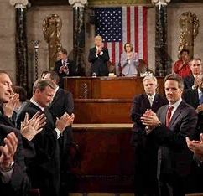
RELAUNCH OF PLO JANUARY 2023
Views from the President’s Chambers
PS Has it made a difference?

Slide 17
PLO AND GREATER EMPHASIS ON COMPLIANCE
Robust case management
Non compliance hearings
How to make PLO work better – work done by SLLCP includes:-
Agenda for each meeting
Draft documentation in advance of all meetings
Keep child at beginning and end of agenda
Consider need for intermediary for parents

Slide 18
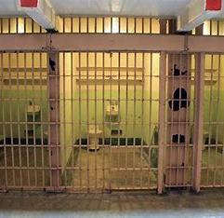
DOLS Specialist Court
The law and the reality…

Slide 19
Mobile phones
Manchester City Council v P (Refusal of Restrictions on Mobile Phone) (Rev1) [2023] EWHC 133 (Fam)
Inherent jurisdiction / powers under s33(3) CA 1989
“it would not be unreasonable for a parent who has become aware that the use by their 16 year old child of his or her mobile phone is placing them at risk of significant harm, for example through child sexual exploitation (because it is apparent that they are being groomed online), or through self harm (because it is apparent that they are watching self harm content on social media), or through criminal prosecution for selling drugs (because it is apparent they are in contact with an OCG), to seek to address that situation by removing or restricting the use of their teenager’s mobile phone and other devices in the exercise of their parental responsibility.”
What is reasonable when exercising parental responsibility?
All fact specific.

Slide 20
It’s all about resources. What can we do as lawyers?
Tameside MBC v L (Unavailability of Regulated Therapeutic Placement)
[2021] EWHC 1814 (Fam)
Lack of regulated placements.
The court will in effect consider itself able to authorise placements under the inherent jurisdiction even where local authorities are not able to use those placements, and those running the placements may be committing a criminal offence.
Fundamental legal tension between welfare best interests jurisdiction and article 5
See also November 2019 Presidents Guidance (review every 12 weeks)

Slide 21
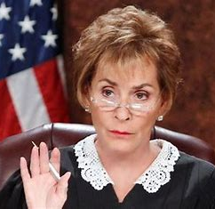
RECENT (ISH) INTERESTING DECISIONS
A random selection

Slide 22
ROLE OF EXPERT AS OPOSED TO JUDGE
H-W (Children: Proportionality)2021 https://www.bailii.org/ew/cases/EWCA/Civ/2021/1451.html
Expert is entitled to make recommendations on basis of concerns not facts.

Slide 23
REOPENING OF FINDINGS
Useful summary of law in Re J (Children: Reopening Findings of Fact) [2023] EWCA Civ 465
there is a 3 stage process:
consider whether to permit any reconsideration,
determine the extent of investigations and evidence that will be considered,
conduct the rehearing.
But….
Re Z (Care Proceedings Reopening of Fact Finding) [2023] EWFC 137
Judge refused application to reopen. Detailed forensic analysis of what might constitute “new information”.
NB consider wording of LOI to expert who may need to be alerted to the fact that they cannot go behind a finding of fact, but that that finding may be reopened.

Slide 24
FACT FINDING HEARING
Lincolnshire County Council v CB & Ors
Lincolnshire County Council v CB & Ors [2021] EWHC 2813 (Fam) (21 October 2021) (bailii.org)
Decision not to order lengthy fact finding hearing (into death of older child).
Decision is case management. Welfare is not paramount. Delay is a significant factor to be considered.
“In respect to whether the Court orders a separate fact finding, such hearings will relatively rarely be necessary or proportionate.”

Slide 25
VACCINATIONS
LA can vaccinate a looked after child without making a separate application to court. This includes Covid 19 vaccinations.
C (Looked After Child) (Covid-19 Vaccination) [2021] EWHC 2993 (Fam) (09 November 2021) (bailii.org)
Court of Appeal Judgment Template (judiciary.uk)

Slide 26
S1 INTERVENTION USE OF S20
Use of s20 as against care order. Parents agreeing to long term placement of chilren beyond parental control. Court of Appeal overturned decision to grant care orders.
Remember that if there is a concern that 1 parent may disrupt the placement, court can grant CAO lives with to the other parent which removes right of the disruptive parent to discharge from accommodation.
S 20 (9) (a) Children Act 1989
S (A Child) & W (A Child), Re (s 20 Accommodation) [2023] EWCA Civ 1 (05 January 2023) (bailii.org)

Slide 27
PLACEMENT OF CHILD AT HOME. WHAT STATUTORY FRAMEWORK?
JW (Child At Home Under Care Order) [2023] EWCA CIV 944
making a care order with a subject child placed at home in the care of their parent(s) is plainly permissible within the statutory scheme and express provision is made for such circumstances in s.22C CA 1989 and in the placement regulations.
the early post-CA 1989 authorities established that a care plan for placement at home was an appropriate outcome where the facts justified it, without the need for exceptional circumstances.
the analysis of Hale J/LJ in Oxfordshire County Council v L [1998] 1 FLR 70and in Re O (Supervision Order) [2001] EWCA Civ 16; [2001] 1 FLR 923 laid particular weight upon the need for the authority to have power to remove the child instantly if circumstances required it, or to plan for the child to be placed outside the family.

Slide 28
RE JW CONTINUED
….
since Oxfordshire and Re O, the High Court decision in Re DE, containing guidance endorsed by the President, has been widely accepted so that, in all but a true emergency, the local authority power to remove a child from their home under a care order should not be exercised without giving parents an opportunity to bring the issue before a court.
the difference concerning removal of a child from home either under a care order or where there is no care order is now largely procedural. In all but the most urgent cases, the decision on removal will ultimately be taken within the umbrella of court proceedings, rather than administratively within a local authority.
sharing of parental responsibility by the local authority with parents is an important element, but, as Hale J/LJ stressed, the fact that considerable help and advice may be needed over a prolonged period is not a reason, in itself, for making a care order.
it is wrong to make a care order in order to impose duties on a local authority or use it to encourage them to perform the duties that they have to a child in need.
the protection of the child is the decisive factor, but proportionality is key when making the choice between a care and supervision order for a child who is placed at home.
supervision orders should be made to work, where that is the proportionate form of order to make.
The court referred to the President’s Public Law Working Group Guidance (“PLWG”), in particular, the main report published in March 2021. The report dealt expressly with the making of care orders where children are placed at home at paragraphs 158 to 162.

Slide 29
Re JW continued
The court noted that HHJ Harris-Jenkins’ principal reason for making a care order was that a supervision order did not have ‘the safeguarding features’ of a care order and that it was necessary for the local authority to share parental responsibility, and if necessary, take the ‘whip hand’, if there was a falling down in the safeguarding position at any point. HHJ Harris-Jenkins did not, however, identify what ‘the safeguarding features’ of a care order in this case were.
What would those “safeguarding features” be??

Slide 30
Remote hearings. Giving evidence from a different jurisdiction
Practice Direction 22A – need to notify authority in foreign state if party will give evidence from abroad.
Indication from Central Family Court that this Practice Direction will not be applied?
Are courts still ordering remote hearings? When/

