Slide 1
Managing Legal Aid Contracts
Matthew Howgate and Vicky Ling

Slide 2
Welcome & Introductions
Vicky Ling
vicky@vling.co.uk
Matt Howgate
matt@mhconsult.co.uk

Slide 3
Some Civil Contract amendments from 1st November 2023
Specification 2.21 (Supervision Standard)
Amended text
Arrangements must be in place to ensure that each Supervisor is able to conduct their role effectively including but not limited to: (a) designating time to conduct supervision of each Caseworker;
(b) designating at least one day per calendar month to be in attendance at each Office at which they supervise staff where you determine that this is required (which must coincide with attendance by staff supervised); and
(c) ensuring that the level of supervision provided reflects the skills, knowledge and experience of the individual Caseworker.

Slide 4
Specification 2.23 (Supervision Standard)
Amended text
Where a Caseworker undertakes Contract Work in a location other than where their Supervisor is based, the Supervisor must conduct, as a minimum, face to face supervision at least once per calendar month with the parties present in the same physical location where you determine that this is required.

Slide 5
Role of contract managers LAA view:
Contract managers normally engage with your LAA contract liaison manager
They ensure that each firm or organisation with a LAA contract complies with the terms of that contract
Contract managers intervene early if there are any issues and work with the provider, as they will have formed a constructive working relationship with your organisation
Contract managers are the main point of contact for your firm’s / organisation’s contract liaison manager on legal aid contract matters:
Check compliance against case files
Monitor performance against key performance indicators (KPIs)
Provide updates on contractual changes
Should be approached on changes to your business practices, including changes to key personnel such as supervisors, business structure, office location

Slide 6
File reviews
Your contract manager will review a sample of controlled work claimed for each category of law. This normally takes place annually.
The sample will need to incorporate different forms of service, for example, legal help, family help (lower), crime lower and different matter types.
For multi-office firms, files will be selected from all offices.
A small sample of open files will also be chosen for review on the day.

Slide 7
File review outcomes
Ideally providers should review files prior to the visit so that they are aware of any issues
A contract notice may be issued if there is a claiming error and costs recouped where appropriate
If this happens, the firm will be asked to self-review files to ensure that there are no other errors
The contract manager will complete contract notice verification activity within 4-6 months of the issue of the contract notice

Slide 8
Compliance against key performance indicators (KPIs) - Civil
Performance indicator | % not to be exceeded
Refused applications for civil funding | 15%
Rejected applications for civil funding | 5%
Rejected claims for certificated costs | 5%
Reductions on escape fee claims | 10%
Reductions on certificated work claims | 15%

Slide 9
Compliance against key performance indicators (KPIs) Crime
Performance indicator | KPI Level
Reductions on assessed claims (Escape fees or non-standard fees) | <15% reduction
Defence solicitor call centre (DSCC) acceptance rate | 90%
Virtual court acceptance (where applicable) | 90%
Provider transfers prior to case conclusion | 95%
Notes:
These KPI's are all published on your PAR report and are taken directly from your claims
Avoid a reduction of more than 15% of your escape and non standard fee claims. Its important that you monitor assessment reductions and address the reasons
To accept at least 90% of calls from DSCC. The 90% target allows for conflicts, sole practitioners unable to take calls whilst in PS.
There are xxx vitual courts nationally so for most providers this is not relevant. for those providers who have a virtual court there is a KPI that they must accept 90% of calls to attend.
Lastly to ensure that 95% or more of cases conclude before the case is transferred to another provider, again this will be taken from the outcome codes reported by you on CWA.

Slide 10
Common Errors Civil:
CW1 form completion and evidence of means
Evidence of disbursements
NMS usage
Delays in submission of certificated and escape case claims
General Contract Issues
Failure to report changes in contact details or changes to business structure/ownership
Failure to report changes to Rejection Criteria – ‘Qualifying Events’ – Clause 21 Standard Terms

Slide 11
Common Errors on File Review Crime:
Travel & disbursement claiming
Court duty claiming
Magistrates court: Standard fee category / cracked trials
Magistrates court: Series of offences
Magistrates court: Designated or undesignated courts
The less commonly-used claim types (eg Pre-Order Cover (PROP code), Early Cover (PROT))
Financial eligibility: Advice & assistance and prison law
Notes:
File Review common errors/issues
Jo touched on the file review process, and so look at common errors in bit more detail.
Easy to get bogged down in detail here, but we'll try not to!
Go through the list above.
We want providers to avoid making these errors & so various support from your CM, to guidance materials & training events (LATER SLIDES)
TRAINING WEBSITE SCREENSHOT LATER ON

Slide 12
Some things to remember…
You must tell the LAA if and when:
Any changes that would have affected the answers in your tender – largely SQQ issues.
Changes in the structure of your firm as this may require formal novation of the contract.
Changes in your capacity to perform contract work – anything that might significantly be expected to affect performance
Changes in supervisors (new supervisors or supervisors that leave or stop supervising)
Changes or closure of offices
Professional body (SRA) proceedings in respect of any of your personnel
You must comply with / have regard to:
Quality standards
Equality & Diversity Guidance
Data Security Guidance / Requirements
Civil Costs Assessment Manual / Criminal Bills Assessment Manual

Slide 13
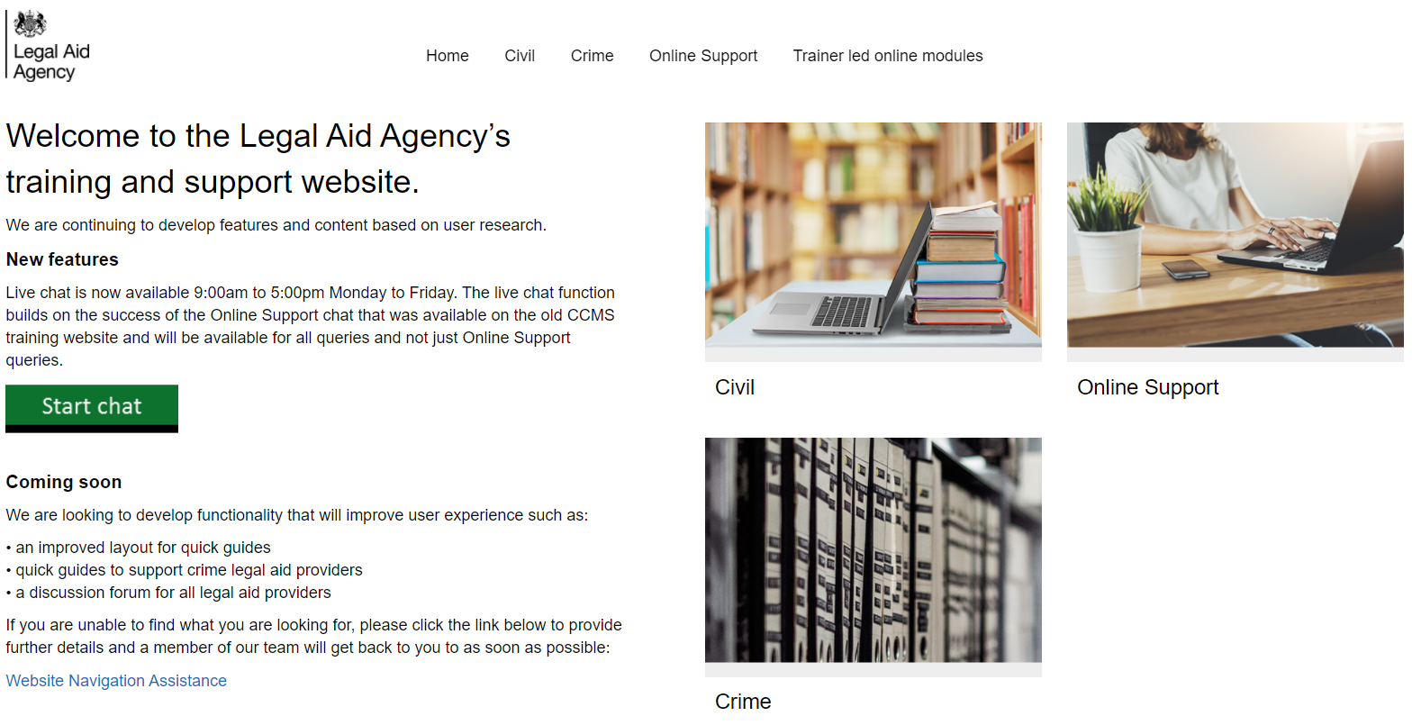
Legal aid agency training website:

Slide 14
What you can find on the website:
CCMS quick guides
CCMS online training
Online support webchat
Getting started
Making an initial application
Managing live cases
Closing cases and billing
Advanced billing
Exceptional case funding
High-cost cases
Sign up on Eventbrite: https://www.eventbrite.co.uk/o/legal-aid-agency-6102545875
Use Webchat if you need help with IT system issues
Webinar recordings
Our ‘Help Us Say Yes’ webinars focus on areas where there have been high enquiry levels, issues raised and helping providers in ‘getting it right first time’
Popular sessions are posted on the training website: Ministry of Justice
Eligibility calculator
Course: CCMS Provider: Means assessments and contributions (justice.gov.uk)

Slide 15
When the LAA don’t get it right first time:
Civil Application Fixer
Email: applicationfixer@justice.gov.uk
Do you think the Legal Aid Agency has made a mistake with your application, amendment or means assessment on CCMS?
This fixer is designed to help reduce appeals and save time during the initial decision-making stages of civil applications
Civil Claim Fix
Email: LAACivilClaimFix@justice.gov.uk
Do you think the Legal Aid Agency has incorrectly rejected your civil claim or outcome?
If they agree they have made a mistake, they will offer a priority re-submission service to help you get paid more quickly

Slide 16
Sanctions
They may apply any Sanction:
if you have materially breached the Contract
if you have persistently breached the Contract meaning:
3 breaches of the same term within any 24 month period; or
6 breaches of this Contract within any 24 month period,
and they need provide you with written notice of each breach.

Slide 17
Formal Review (CRB)
If you disagree with any decision we make following our informal reconsideration pursuant to Clause 27.1, or if we have not reconsidered the matter and advised you of the outcome within 28 days of your request under Clause 27.1:
(a) if you wish to pursue the dispute and are permitted to do so under Clause 27.4, you must, subject to the remainder of this Clause 27.2, request a formal review; or
(b) if you cannot request a formal review under Clause 27.4, Clause 28 will apply, provided that the matter is not one contemplated under Clause 27.5 or 27.7.
Informal Review
If you disagree with any action we have taken or not taken, or a decision we have made, under this Contract you must, through your Contract Liaison Manager, provide details of the matter in writing to our Contract Manager to request an informal reconsideration of the action, inaction or decision. Any such request must be made within 21 days of the action or inaction or the date we notify you of the decision.

Slide 18
Key changes for the 2024 Civil Contract
Supervisors will be able to supervise fee earners in more than one category of law. There is no limit set within the General Specification on the number of categories a person can supervise or restrictions on whether they can cross-supervise civil, family and crime. Limits are however set by the category specific requirements.
The FTE (Full Time Equivalent) remains in some categories but more flexibility on working hours is being introduced.
The requirement for supervisors to attend each office that they supervise at least one day per calendar month has been removed.

Slide 19
Providers can now make their own decision on whether face-to-face supervision (in the same location) is required and how often supervision is required (matching the crime contract).
The requirement that a supervisor must not supervise more than four caseworkers across a maximum of two offices or across two providers with one office each has been removed – but remains subject to the 1FTE to 4FTE requirement.
The requirement for a supervisor to only be employed by one provider has been removed.

Slide 20
Residential property has been added as an exclusion as a type of office.
For the purposes of the permanent presence requirements, you may now operate an office in a shared building such as another legal services provider’s premises or in a serviced office arrangement, but must have a right of access to the office at all times during Business Hours for the purpose of providing face-to-face legal services at that office.

