Slide 1
Private Law Update
Jenny Beck KC (Hon)

Slide 2
Summary
Harm panel report: 3 years on
Alienating behaviours
Current operational issues
NFJO

Slide 3
Harm panel report: 3 years on
Ministry of Justice: Assessing risk of harm to children and parents in private law children cases - GOV.UK (www.gov.uk)
Systemic barriers
Resource constraints
Pro-contact culture
Silo working
Adversarial system

Slide 4
Harm Panel Action
Pathfinder pilots
DAC monitoring and reporting mechanism
The Family Court and domestic abuse: achieving cultural change - GOV.UK (www.gov.uk)
Review of the presumption of parental involvement

Slide 5
Alienating Behaviours
Experts and Process
.

Slide 6
Experts
President’s Memorandum: Experts in the Family Court - Judiciary.UK
Re C (‘Parental Alienation’; Instruction of Expert) [2023] EWHC 345
The British Psychological Society: Psychologists as Expert Witnesses in the family courts in England and Wales: Standards, competencies and expectations

Slide 7
Process

Slide 8
Current Operational Issues
Issuing difficulties and representation deserts
Practice Guidance: Non-Molestation Injunctions
QLRs

Slide 9
Challenges and Opportunities: Learning from research to improve outcomes for families
Reflections from NFJO

Slide 10
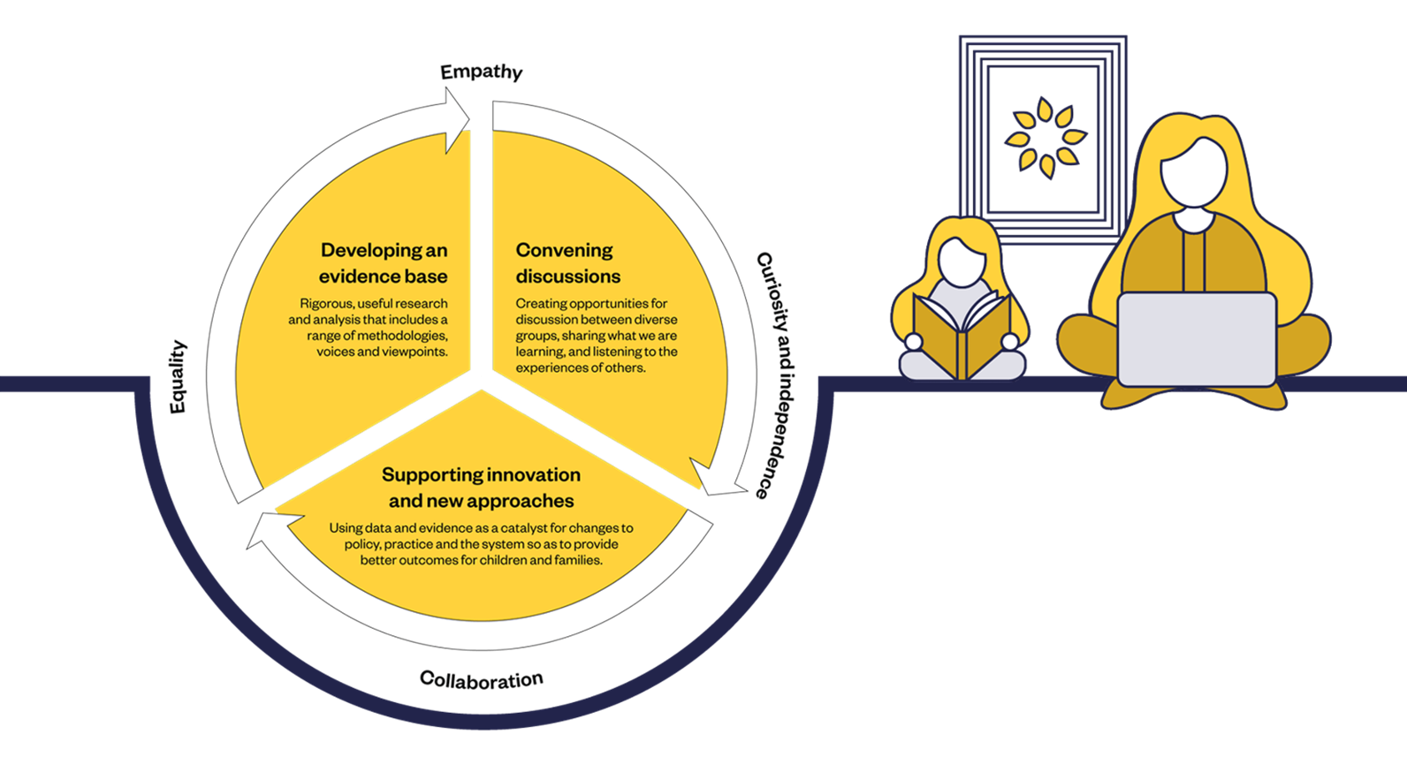
An introduction
to NFJO

Slide 11
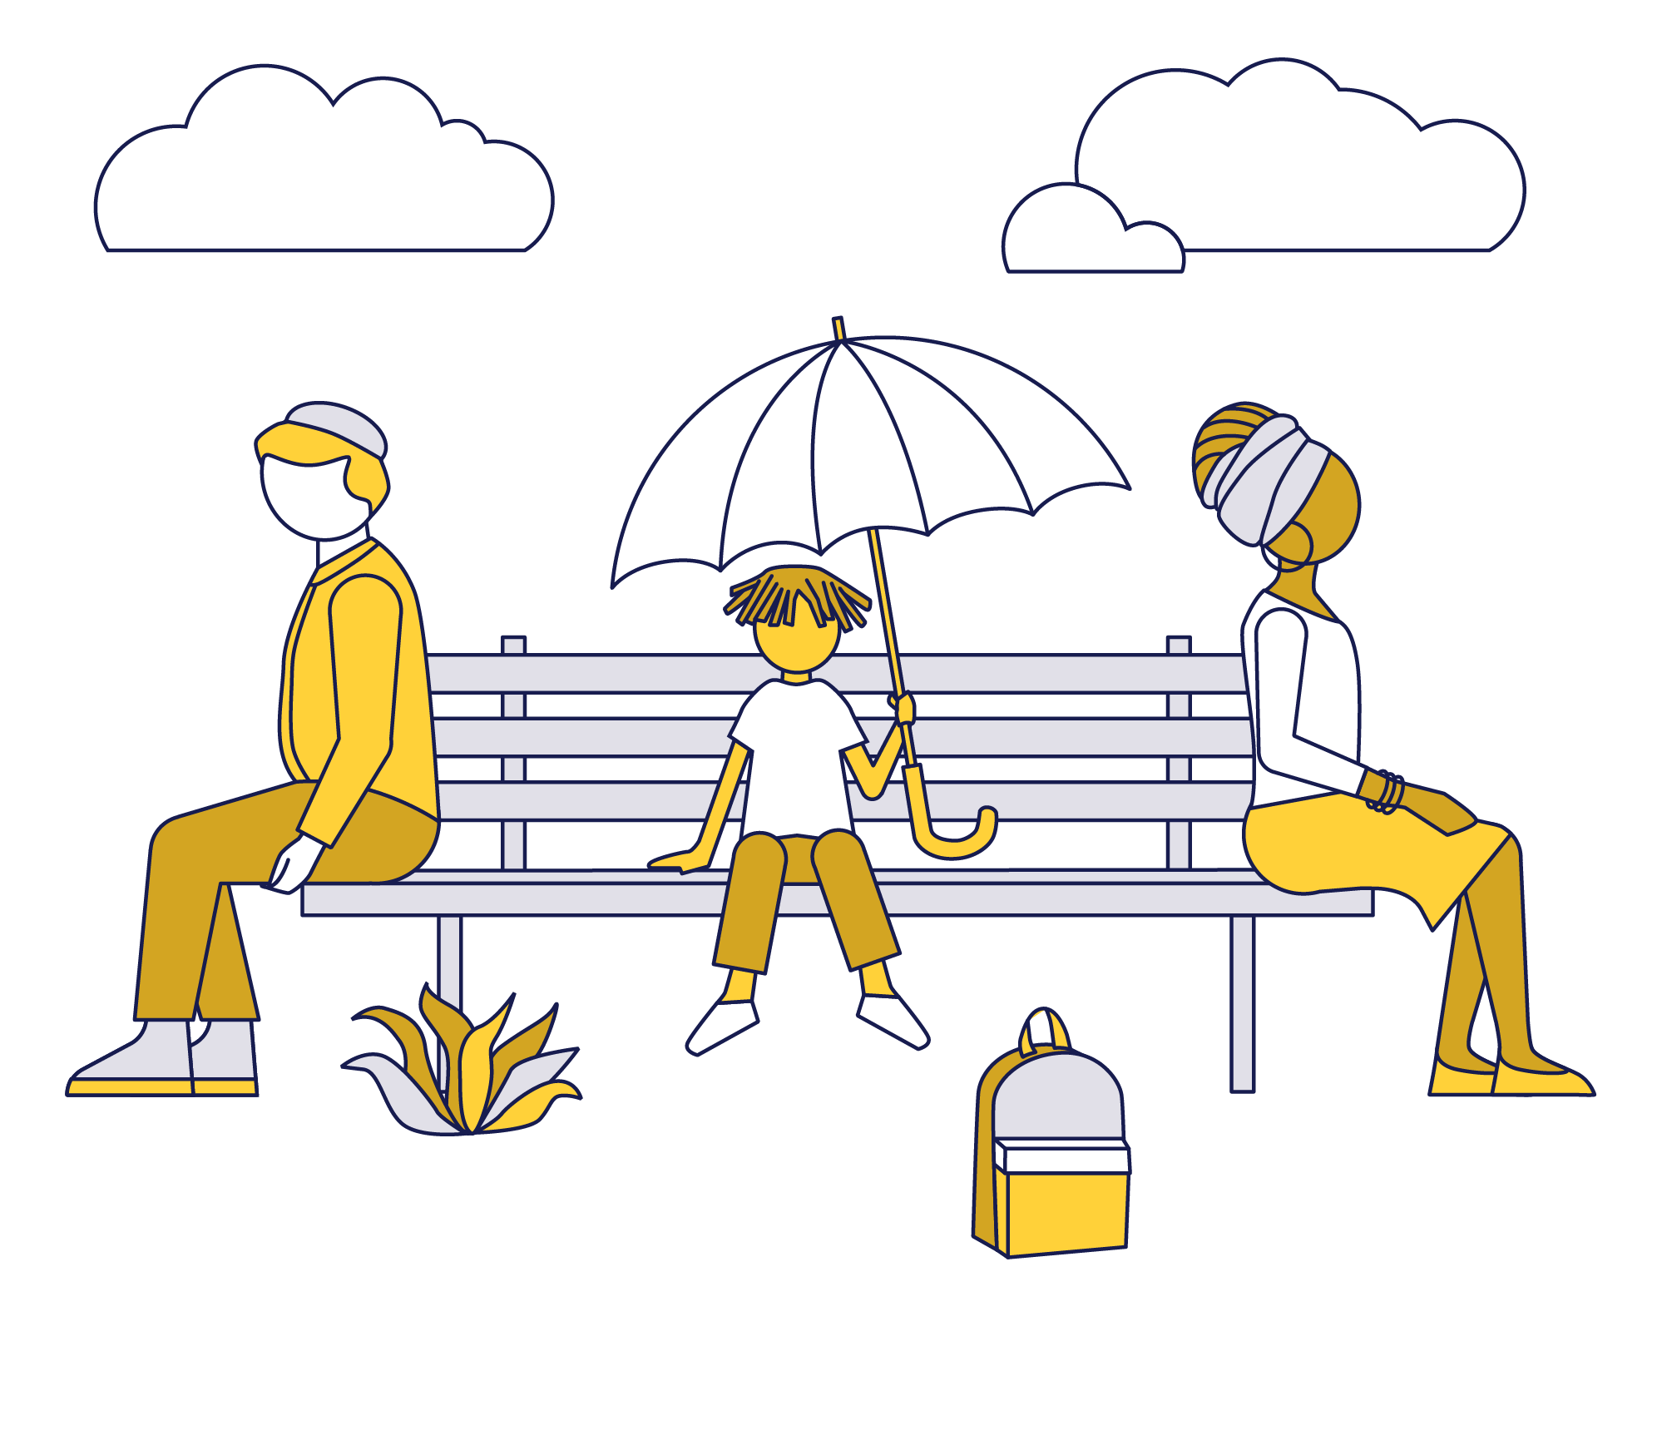
Private law – an evidence jigsaw with lots of missing pieces
About three times as many private law applications are made each year as public law applications but much less is known about the characteristics and experiences of the court population.
Even less is known about those who separate and don’t go to Court.

Slide 12
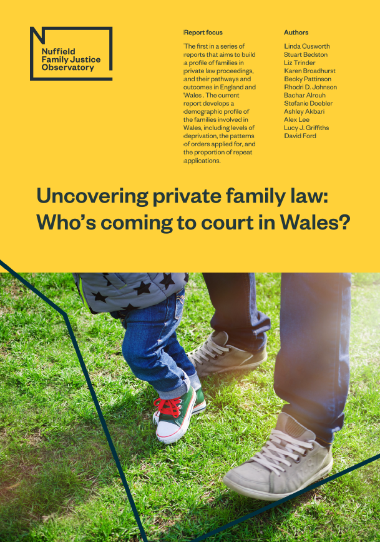
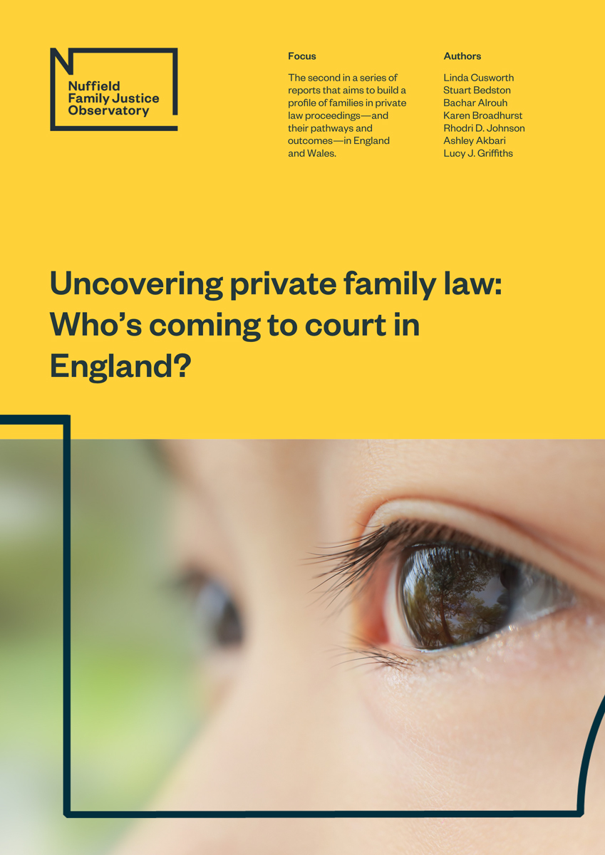
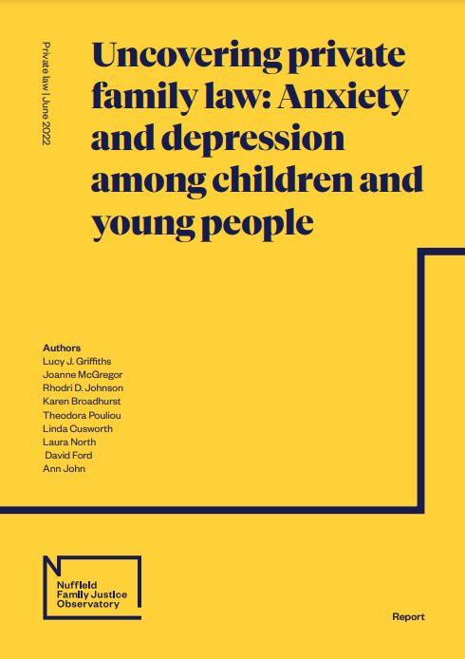
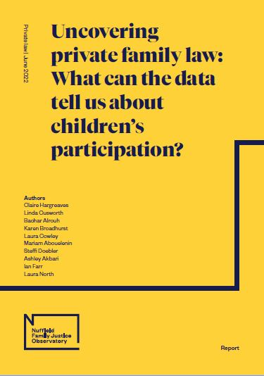
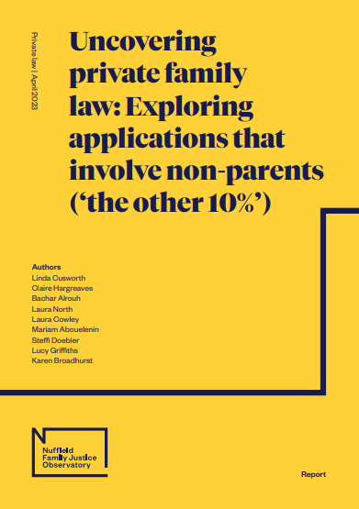
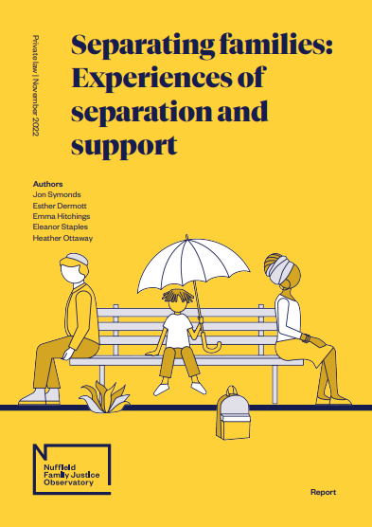
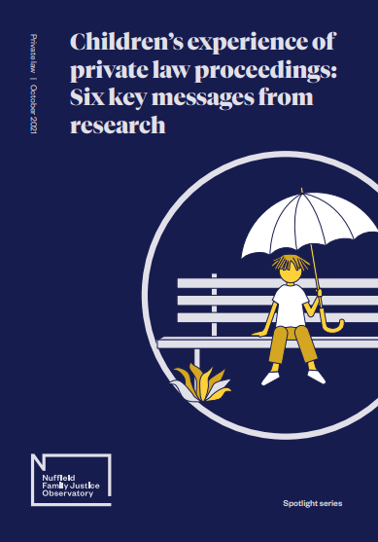
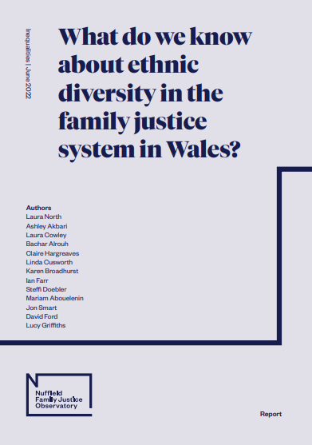
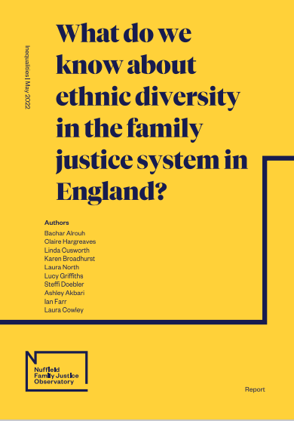
Filling gaps in the evidence relating to private law

Slide 13
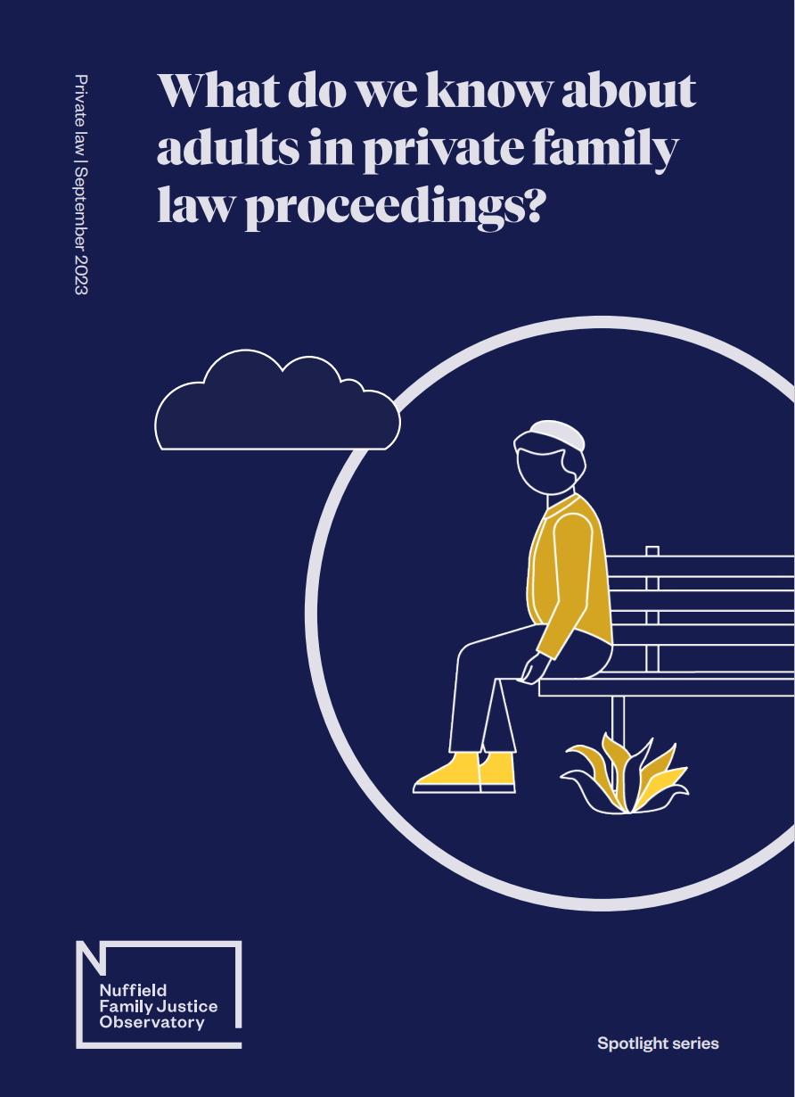
Spotlight on what we know about adults in private law proceedings
Families in private law proceedings often face deprivation
Court is a last resort for separating Families
There is an over-representation of adults from some ethnicities other than ‘White’
About 10% of applications also involve ‘Non-Parents’
Health issues disproportionately effect families going through court
Domestic abuse effects many families in private law proceedings
Rates of adults representing themselves in private proceedings is growing
Notes:
What do we know about adults in private law proceedings? Spotlight series - Nuffield Family Justice Observatory (nuffieldfjo.org.uk)

