Slide 1
Managing Remotely and Hybrid Working
Matthew Howgate and Vicky Ling

Slide 2
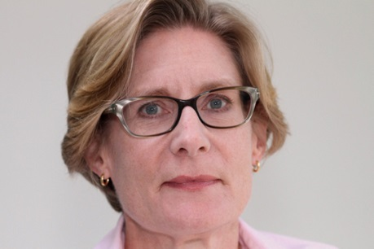
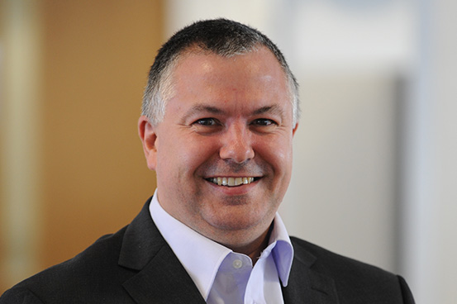
Welcome & Introductions
Vicky Ling
vicky@vling.co.uk
Matt Howgate
matt@mhconsult.co.uk

Slide 3
What gets your vote?
In the Office?
Remote?
Hybrid?

Slide 4
Recent research
Legal Futures 2023 found that currently 58% were hybrid working, 13% fully remote and 29% in the office full time
The majority of lawyers preferred hybrid or remote working
A recent American Bar Association study found that young lawyers feel so strongly about remote working that 44% of them say they would leave their current jobs for a greater ability to work remotely elsewhere
BigHand found that almost as many would leave if they had to attend office more than three days a week

Slide 5
Back to the office?
BigHand found around 40% of firms wanted staff to increase their days in the office
This was due to the challenges presented by managing staff remotely and perceived drop in productivity
However, 2/3rds of respondents said they had experienced no drop in productivity

Slide 6
Law Society Guidance
Law Society guidance on how supervision of junior staff and trainee lawyers can be effective in a hybrid working environment
phone calls
video conferencing
email
other appropriate measures available, e.g. Teams, other software platforms
Depending on the nature of the work junior staff are carrying out, a mix of different communication methods may be appropriate
However, it's important that junior staff communicate regularly in person when possible, whichever other methods are used

Slide 7
SRA guidance on supervision – Nov 2022
Quality of legal awork
Whether the practice’s policies have been followed
Any relevant ethical and regulatory considerations
Management of the file
Recording supervisory arrangements
Remote, hybrid and agile working
Freelancers, advocacy, trainees and other legal professionals, reserved legal activities

Slide 9
Standard Civil Contract 2018 – From 01 November 2023
Amended text para 2.21
Arrangements must be in place to ensure that each Supervisor is able to conduct their role effectively including but not limited to:
(a) designating time to conduct supervision of each Caseworker;
(b) designating at least one day per calendar month to be in attendance at each Office at which they supervise staff where you determine that this is required (which must coincide with attendance by staff supervised); and
(c) ensuring that the level of supervision provided reflects the skills, knowledge and experience of the individual Caseworker.
Amended text para 2.23
Where a Caseworker undertakes Contract Work in a location other than where their Supervisor is based, the Supervisor must conduct, as a minimum, face to face supervision at least once per calendar month with the parties present in the same physical location where you determine that this is required.

Slide 10
Some practical tips for managing and supervising home / remote workers
Be clear yourself (and with your team) about what you expect them to do remotely and what you expect them to do in the office (and be clear and consistent about what that dividing line is).
Remember that this can’t work by osmosis. Set Deadlines on Tasks and Projects and clear targets and deliverables. Know yourself what ”good” looks like and communicate that to your team members. Setting deadlines for tasks and projects keeps employees focused on the goal without micromanaging them. Ensure that your team members know what is expected of them at all times.
Work out clear timelines (milestones) and success measures which are directly linked to what “good” looks like.

Slide 11
Think about and understand the most common work from home / remote working challenges and what you can do about them. They are likely to be:
Zoom fatigue
Isolation and lack of time with colleagues
Lack of communication
Distractions
Provide the right tools. Think about what they need and need access to in order for them to do the job properly and deliver the “good” that you have identified.
Watch out for signs of stress, anxiety and burnout. Understand the signs and look for them. Asking your team periodically if they are OK is almost certainly not enough. Ask them again and look for signs that performance is falling.

Slide 12
Set clear parameters. Flexible working is great, but you need to protect your staff from allowing work to bleed too much into home life. Remember, we are not working from home – we are not largely living at work!
Communicate – regularly and in ways specific to the individual staff members. Remember that open door supervision doesn’t work remotely because the door is in a different building to the people being supervised.

